Slide 1
U.C. Berkeley: Economics 115: Spring 2020
20th Century Economic History: Lecture 18: Globalization, Technology, and Organization
Brad DeLong
Department of Economics & Blum Center, U.C. Berkeley; & WCEG
delong@econ.berkeley.edu
last revised: 2020-04-20
for delivery: 2020-04-27
<https://bcourses.berkeley.edu/courses/1487684>
<https://github.com/braddelong/public-files/blob/master/econ-115-lecture-18.pptx>
<https://www.icloud.com/keynote/0IMJ4CGSNSe9Hl8O6bsHfbfkg>

Slide 2

Globalization, Technology, and Organization
Income distribution:
Steep fall in demand for “lesser-skilled” workers in the global north 1975-1995
Blamed by both left and right on increasing world trade
A striking turnaround from 1960s and 1970s
Was this argument right?
Trade deficits?
But average wage rising in countries exporting to the U.S.
Countries joined the global north faster than countries became exporters
17:00 minutes of audio
3:15
Notes:
Since 1970, the relative demand for lesser-skilled workers has fallen sharply in advanced industrial countries. In western Europe that decline in demand initially showed itself as a rise in unemployment. In the United States this fall in demand showed up as falling real wages for lesser-skilled men.
Both the left and the right blamed increasing world trade for this fall in demand for the work of the lesser skilled--and especially increasing imports from developing economies. This was a striking turnaround from earlier positions: in the 1960s and 1970s developing countries had feared "unequal exchange" and immiserization from trade. The argument was that the increase in income inequality had come about at the same time as a sharp rise in world trade. In the United States imports were six percent of GDP in 1970 (and exports six percent as well), but were twelve percent of GDP in 1990 (and exports were ten percent, as Americans borrowed some two percent of GDP from foreigners to finance investment). Imports from low-wage countries were, it was argued, destroying the jobs of Americans. Never mind that if imports destroy then exports create, and foreign-financed investments create jobs--and the fact that imports must by arithmetic equal exports plus net foreign-financed investment creates a strong presumption that the net employment effect of trade is zero. But the fact on which critics of trade rested their case turned out not to be a fact at all: manufacturing imports were not increasing as a share of the American economy. In 1975, the average non-oil import came from a country where the manufacturing wage was 60% of the U.S. level. By the early 1990s the average non-oil import came from a country where the manufacturing wage was 75% of the U.S. level. How could this be? Consider: In 1975 Japan was a low-wage economy: its manufacturing wage was less than half of the U.S. manufacturing wage level. Think of it: Japan and Italy in as economies that had enormous labor cost advantages vis-a-vis the U.S. Today Japan is a high-wage economy: its manufacturing wage is higher than the U.S.
In 1975 Taiwan, Singapore, and Korea were very low-wage economies with wage levels one-twentieth that of the United States. Today their manufacturing wage levels are about a third of the American standard. Because our trading partners are growing richer faster than new low-wage trading partners are appearing, the average wage in countries trading with the U.S. is increasing rapidly. Doesn't this mean that international trade was placing more downward pressure on American wages in 1975 than it was in 2000? Doesn't this mean that the changing international economy has on net exerted upward pressure on American wages over the quarter century from 1975-2000?
It would seem so.

Slide 3
Why the Decline in Blue-Collar Jobs?
Regional shifts in the United States
The decline of New England manufacturing
Brockton, MA-South Paris, ME-and then the jobs went to NC
Lakeland, FL
Wellman-Lord company
Wellman-Lord process
Shift in blue-collar job location
2000s: shift out of midwestern manufacturing, into sunbelt construction
But then comes the Great Recession
3:00
Notes:
Nor was there reason to believe that the reduction in the share of Americans who held blue-collar jobs was the result of expanded imports from the developing world. Blue-collar jobs as a share of total non-agricultural jobs had been falling steadily since 1945. Even more, blue-collar manufacturing jobs were being destroyed at a furious rate. But before the 1970s the lost jobs in one region and sector were generally being replaced—in absolute terms, if not as a share of the labor force—by new jobs in another region or sector.
Consider the career of my grandfather, William Walcott Lord, who was born in New England early in the twentieth century. In 1933, his Lord Brothers Shoe Company in Brockton, Massachusetts, was facing imminent bankruptcy. So he relocated his operations to South Paris, Maine, where wages were lower. The Brockton workers were devastated by this move, and by the widespread destruction of relatively high-paying blue-collar factory jobs across Southern New England. But in the aggregate statistics, their loss was offset by a bonanza for the rural workers of South Paris, who went from slaving away in near-subsistence agriculture to holding a seemingly steady job in a shoe factory.
The South Paris workers’ good fortune lasted for just 14 years. After World War II, the Lord brothers feared that depression could return, so they liquidated their enterprise and split up. One of the three brothers moved to York, Maine; another moved to Boston. My grandfather went to Lakeland, Florida – halfway between Tampa Bay and Orlando – where he speculated in real estate and pursued non-residential construction. Again, the aggregate statistics didn’t change much. There were fewer workers making boots and shoes, but more workers manufacturing chemicals, constructing buildings, and operating the turnkey at the Wellman-Lord Construction Company’s Florida-based phosphate-processing plants and other factories. In terms of domestic employment, the Wellman-Lord Construction Company had the same net factor impact as Lord Brothers in Brockton. The workers were different people in different places, but their level of education and training was the same.
So, during the supposedly stable post-war period, manufacturing (and construction) jobs actually moved en masse from the Northeast and Midwest to the Sun Belt. Those job losses were as painful for New Englanders and Midwesterners then as the more recent job losses are for workers today.
Likewise, during the 2000s, American blue-collar jobs were churned more than they were destroyed.

Slide 4
Why the Decline in Manufacturing Jobs?
1943 the high point—World War II demand
Normal share: 30%
Had the U.S. followed the economic policy strategy of Japan or Germany…
Technology would have brought that 30% down to 12% today
Instead, we are at 8.6%
12% to 9.2% due to dysfunctional macroeconomic policies
Reagan and Bush budget deficits
Reagan and Bush trade deficits
Derangement of U.S. away from its standard role as capital exporter
The China shock
Hits manufacturing, not blue collar…
2:30
Notes:
In 1943, 38% of America’s nonfarm labor force was in manufacturing, owing to high demand for bombs and tanks at the time. After the war, the normal share of nonfarm workers in manufacturing was around 30%. Had the US been a normal post-war industrial powerhouse like Germany or Japan, technological innovation would have brought that share down from 30% to around 12%. Instead, it has declined to 8.6%. Much of the decline, to 9.2%, is attributable to dysfunctional macroeconomic policies, which, since Ronald Reagan’s presidency, have turned the US into a savings-deficit country, rather than a savings-surplus country.
As a rich country, the US should be financing industrialization and development around the world, so that emerging countries can purchase US manufacturing exports. Instead, the US has assumed various unproductive roles, becoming the world’s money launderer, political-risk insurer, and money-holder of last resort. For developing countries, large dollar assets mean never having to call for a lifeline from the International Monetary Fund. For rich people in poor countries, having assets invested in the United States is the best form of political risk insurance.
What about the rest of the decline? From 9.2% to 8.6%.
From 2000-2019, the relative wage of the country from which the average non-oil import came to America fell sharply as China stood up. China contributed a huge share of manufactured imports. Yes, there was a decline in the share of manufacturing jobs in America from 9.2% to 8.6% from the rise of China. (The North American Free Trade Agreement, contrary to what US President Donald Trump has claimed, contributed almost nothing to manufacturing’s decline.) Yet the pace at which the share of Americans holding blue-collar jobs declined did not accelerate. Yes, goods imports from China crowded out American manufacturing jobs. But investment in America from China funded construction jobs. What devastated the standard of living of blue-collar Americans in the years after 2000 was not imports from China, but the financial crisis and the Great Recession.

Slide 5
Why Blame Globalization?
It does receive the lion’s share of the blame: why?
As trade barriers drop, ratio of total win to redistribution rises for further drops
Distribution of wealth nd power by gender
Easy to blame foreigners
Rise of China coincides with a shaky period
The China shock hit a shaky economy
Cannot run an open, global economy without a full employment guarantee
3:00
Notes:
And yet globalization—increasing international trade—continues to receive the lion’s share of the blame for economic distress, even in the world’s richer economies. Why is this? Harvard University economist Dani Rodrik frequently points out that as trade barriers decline, the net benefits from further reductions decline while the redistributions induced remain about the same in scale. The redistributions thus become very large relative to the net gains—and, in the limit, what we have is simply a near-zero sum redistribution, and a redistribution away from those who held some social power, or else they would not have been able to benefit from the trade barriers in the first place.
And there are different dimensions along which any country is divided. The shift in US employment from assembly-line manufacturing to construction, services, and caretaking had very little impact on the overall distribution of income in terms either of social class or of the shape of the income distribution curve. But it did have a large effect on the distribution by gender: the jobs closing down were traditionally not just blue-collar but male, and always remained overwhelmingly male. The jobs opening up were very different.
But there have been other factors at work. First and foremost, it is easy for politicians to pin the blame for a country’s problems on foreigners and immigrants who do not vote. Back in 1890, when politicians in the Habsburg Empire routinely blamed Jews for various socioeconomic ills, the Austrian dissident Ferdinand Kronawetter famously observed that “Der Antisemitismus ist der Sozialismus der dummen Kerle”: anti-Semitism is the socialism of fools. The same could be said of anti-globalization today. Second, more than a generation of inequitable and slower-than-expected economic growth in the global North created a strong political and psychological need for scapegoats. People want a simple narrative. They will find one.
Third, China’s economic rise coincided with a period in which the global North was struggling to reach full employment. Successful economic readjustments do not happen when bankruptcies force labor and capital out of low-productivity, low-demand industries, but rather when booms pull labor and capital into high-productivity, high-demand industries. That the “China shock” hit a shaky economy made it much more likely that it would be perceived as, and that it would be, substantially destructive.
It is a fact that successful market adjustment via creative destruction does not just require open and competitive markets, global change, and price stability. It also depends on full employment and near-permanent booms, just as economist John Maynard Keynes had warned in the 1920s and 1930s. But the neoliberal order failed to prioritize—and even more so failed to deliver—consistent full employment. But when the economy was booming in the 1990s, complaints about NAFTA were very small and very limited: it was only after unemployment rose that it could be ginned up to be an issue in U.S. politics again.

Slide 6
What Has Globalization Actually Done?
The Belle Epoque world was globalized
Are there significant differences? In trade? In embedded factor content? In migration? Some
Limited bandwidth: commodities could move and securities could be traded back in the Belle Epoque
Ford could not achieve U.S. productivity levels in Britain
Today we have high bandwidth globalization
Integrated value chains
Blame “rootless cosmopolitans”
But not advanced very far
4:00
Notes:
So if "globalization" did not impoverish the workers of major industrial economies, what has "globalization" done? The question is sharpened by thinking back to the pre-WWI Belle Epoque, which was as "globalized" as today. In pre-WWI Britain, in industry by industry British producers decried their losses of export share to German and American producers. My wheat-farming great grandparents in Illinois, whose prices hinged on European demand for grain would have been astonished to have been told that they were not part of an integrated economy. So what is the difference? Are financial flows stronger and more important today? Probably not. Net capital flows as shares of world product are surely smaller than they used to be before WWI (although gross trading volumes are higher). Is trade stronger and more important? Maybe: world trade as a share of world product is a bit larger. But the net embodied factor content of trade as a share of world product appears smaller, and the net embodied factor content is presumably what matters most for trade's effect on, say, the unskilled workers' wages. How about labor? Is international migration more important?Certainly not: between 1850 and 1920 one in every ten people in the world moved continents. Post-WWII, post-1973, or even post-1990 world population flows are a far smaller share of world populations than in the old days. So what is different? Why has "globalization" become such a powerful banner in the past decade? One possibility: back before the Belle Epoque, what you could transfer across national boundaries was limited--pretty much limited to the commodity, or the security. As long as you could pack it in a crate or an envelope, and send it across the sea (or over the telegraph lines), you could transfer it. If not, not. Call this "low bandwidth" trade. International transactions and linkages that required more in the form of cross-border linkage were very hard to accomplish. Think of Ford's early post-WWI attempts to transfer its assembly-line productivity to Britain; of British and Japanese attempts to use Lancashire-manufactured textile machinery to achieve high productivity in factories in India or China; or of the frantic attempts of British investors--who had never imagined how easily Jay Gould would be able to buy the courts of New York--to extract bond coupons and dividends from the Erie Railroad that they "owned". Today we have "high-bandwidth" trade and investment. The breadth of cross-national links has vastly increased. Back then you could not exercise corporate control across national borders. Now you can. Back then you could not transfer forms of organization to achieve home-country productivity in foreign production operations. Now you can. Back then you could not integrate design and specification in one country with production in another. Now you can. There are counterforces: trans- or multi-national corporations are going to be a good candidate for someone to blame. We are beginning to see denunciations of "rootless cosmopolitans", of "Goldman-Sachsonomics", that somehow seem to me reminiscent of the old-style European contrast between good engineers and bad financiers. Where that will end up I do not know... And this shift to "higher bandwidth" in international economic links is still hard to see in its impact on the aggregate numbers--yet. The modal service export from the United States in the 1990s was not a computer program written by a symbolic analyst in an office tower to program NC machine tools oiled by someone in Malaysia, but was in travel and tourism--the modal service export was someone making a bed for a Japanese tourist outside of Yellowstone.

Slide 7
But Perhaps It Has Not Yet Wreaked Its Effects
Is the right answer: “not yet”?
Robert Reich’s The Work of Nations
A more fine-grained international division of labor
Value chains
Heaven help “unskilled” workers int eh global north
Effects of growing international inequality
Will that come to the domestic side
How will societies survive?
What will the world of 2050 look like?
1:15
Notes:
But perhaps all that critics of those who trace first-world income distribution to third-world exports are saying was not yet. That the vision found in, say, Robert Reich's Work of Nations--one in which the division of labor becomes global at a very finely-grained level, and God help those citizens of rich countries who find themselves among the unskilled--was not yet a powerful force, at least as far as the U.S. economy was concerned. Think back to 1700, and note that then the "rich" countries had perhaps twice the material standard of living of the "poor", and that this relative gap has been widening since. By 1900 the industrialized "rich" had perhaps six times the material standard of living of the world's "poor" countries. And today? 20 times? In the long run our descendants will probably not live in a world in which relative international differences in material standards of living are as large as today. And if by 2050 the gap between "rich" and "poor" has shrunk back to a factor of 6, I pray that it will have been by levelling up--by granting software programmers in Bangalore three-bedroom houses like those in Los Gatos, and by giving auto workers in Hermosillos high enough purchasing power to buy the cars that they make.

Slide 8
Catch Our Breath…
Ask a couple of questions?
Make a couple of comments?
Any more readings to recommend?

Slide 9
About the Course
The long 20th century will in all likelihood be seen in the future as the watershed in human experience:
Nine aspects:
History was primarily economic—and that was true for the first time…
Explosion of wealth: 2%+ per year…
Cornucopia of technology…
Demographic transition…
Feminist revolution…
Empowered tyrannies…
Wealth gulfs…
Inclusion and hierarchy attenuation…
Mismanagement and insecurity…
The global public health system and global epidemic transmission
Humanity is unlikely to see as transformative—for good and ill, but mostly for good, so far at least, I think—a century again…

Slide 10
Questions…
Things we would like to know:
Where do you expect to be located for the rest of the semester?
What aspect of our class are you most worried about?
What outside factors do we need to be aware of that impact your ability to participate in this class for the rest of the semester?
Beyond our class, what is your main worry for the upcoming weeks?
Do you have Wi-fi where you are staying?
Yes - on a computer or tablet
What kinds of devices do you have access to currently? Computer with a camera and microphone? Computer without a camera or microphone? Phone with a camera that can do video? Tablet with a camera that can do video?
Is s data usage a concern when viewing videos where you are?
Are you able to keep up with the lectures and class work? Is there anything challenging or beneficial to your learning in the new format?
What questions do you have for us?

Slide 11
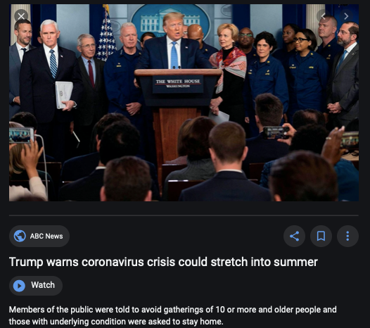
Coronavirus!

Slide 12
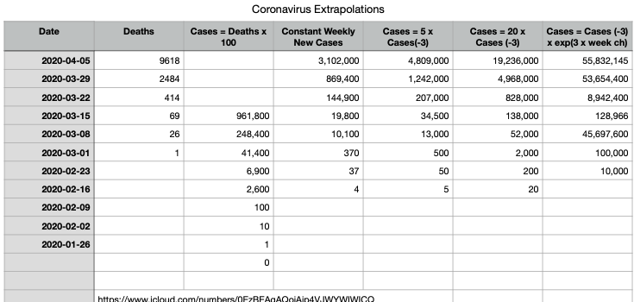
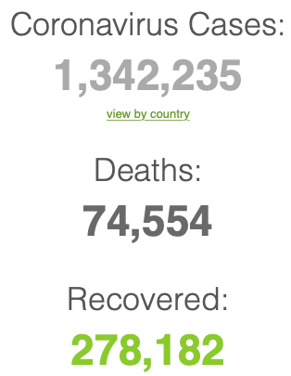


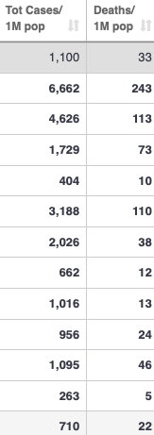
Coronavirus
Where we think we are, as of Mo Apr 6:
We really do not know
No random samples…
Best thing I have read comes from Jim Stock <https://drive.google.com/file/d/12MV466ZZy5xHir4xdPhoTrL1oO8CbZU-/view>:
The basic SIR epidemiological model of contagion
The effect of social distancing and business shutdowns on epidemic dynamics enters the model through a single parameter: the case transmission rate β
Re-express the model in terms of β and the asymptomatic (or not very symptomatic) hence non-tested rate—the fraction of the infected who are not tested
The COVID-19 non-testing rate is unidentified in our model
Estimates in the epidemiological literature range from 0.18 to 0.86.
The asymptomatic rate could be estimated accurately and quickly by testing a random sample
The optimal policy response and its economic consequences hinge critically on the asymptomatic rate

Slide 13
Where we think we are, as of Mo Apr 6:
We really do not know
No random samples…
Best thing I have read comes from Jim Stock <https://drive.google.com/file/d/12MV466ZZy5xHir4xdPhoTrL1oO8CbZU-/view>:
The basic SIR epidemiological model of contagion
The effect of social distancing and business shutdowns on epidemic dynamics enters the model through a single parameter: the case transmission rate β
Re-express the model in terms of β and the asymptomatic (or not very symptomatic) hence non-tested rate—the fraction of the infected who are not tested
The COVID-19 non-testing rate is unidentified in our model
Estimates in the epidemiological literature range from 0.18 to 0.86.
The asymptomatic rate could be estimated accurately and quickly by testing a random sample
The optimal policy response and its economic consequences hinge critically on the asymptomatic rate

Slide 17

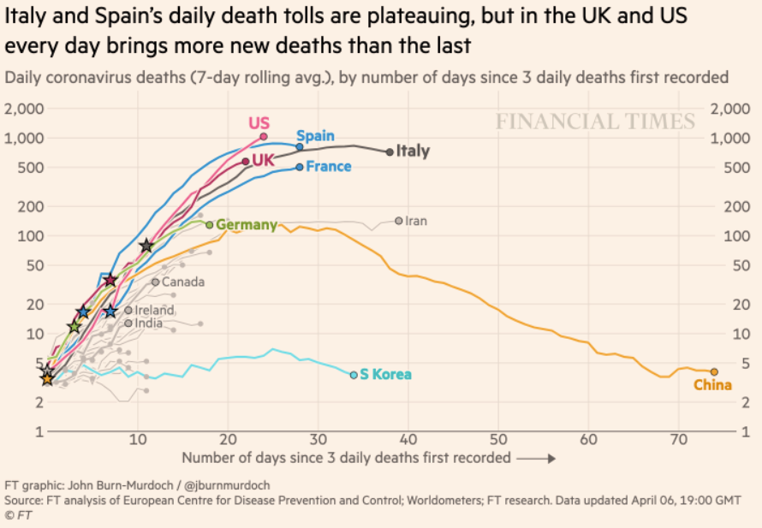
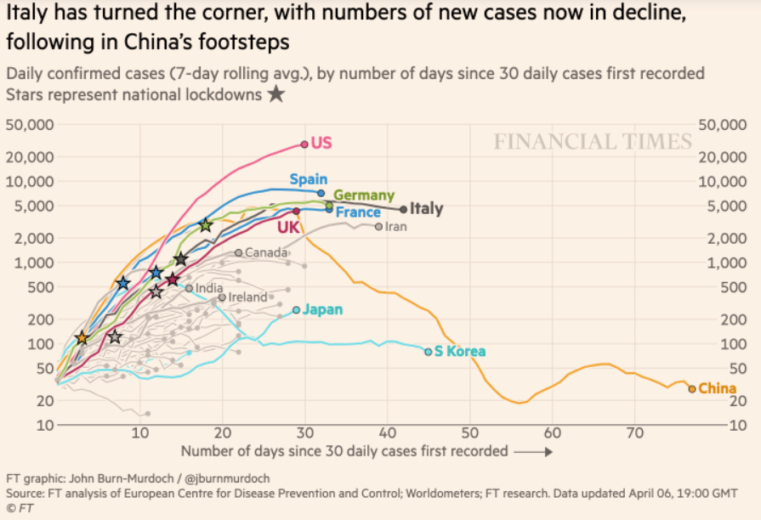
Financial Times Graphs Blown Up…

Slide 21



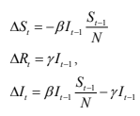
James Stock (2020)
Standard SIR model:<https://drive.google.com/file/d/12MV466ZZy5xHir4xdPhoTrL1oO8CbZU-/view>:
Susceptible, Infected, Recovered (& immune), transmission rate β, recovery rate γ, reproduction number R0, asymptomatic hence non-tested rate π0
Calibration: half-life of infection one week: γ = 0.5, s0 = 0.02, 50 cases on Jan 24
For March 21, 2020, the positive test rate in the United States is approximately 10%…
<https://drive.google.com/file/d/12MV466ZZy5xHir4xdPhoTrL1oO8CbZU-/view>

Slide 26
Bringing the Economy Back Up from Anæsthesia
Major issues:
Certificates of immunity:
Which requires test, test, test:
And not just disease virus tests
Presence-of-antibodies tests
How quickly can we match the immune with public-contact jobs?
What jobs can be done with minimal infection risk?
What minimal-infection substitutes can we find for previous jobs?
How quickly can restrictions be relaxed without the virus coming roaring back?
How do we avoid having the market give a “shutdown” signal to enterprises we in fact want restarted?
Which is pretty much all of them
How much of the potential caseload do we want to push out beyond the vaccine-arrival date?
ALL THESE QUESTIONS ARE ANSWERABLE IF WE LEARN THE ASYMPTOMATIC HENCE NON-TESTED RATE!!

Slide 27
Keeping the Economy from Crashing During the Lockdown
Nick Rowe: We have a 50% output cut in 100% of the sectors:
A temporary 100% output cut in 50% of the sectors (what the Coronavirus does) is very different from a 50% output cut in 100% of the sectors
Nick’s thought experiment:
In three months we are going to invent unobtanium:
Substantial intertemporal substitutibility
Plus lower cross-good contemporaneous substitutitbility
Hence high desired savings rate now
Flex-price market thus produces a nominal rate at the zero lower bound and a high inflation rate over the next three to six months
Plus liquidity-constrained workers in affected sectors see their demand go to zero immediately
Can we get there? Should we get there? What should we do instead?
We need a good RBC economist: are there any?…
<https://worthwhile.typepad.com/worthwhile_canadian_initi/2020/03/relative-supply-shocks-unobtainium-walras-law-and-the-coronavirus.html>

Slide 28
Keeping the Economy from Crashing During the Lockdown II
Nick Rowe <https://worthwhile.typepad.com/worthwhile_canadian_initi/2020/03/relative-supply-shocks-unobtainium-walras-law-and-the-coronavirus.html>:
Plus: to extend the thought experiment:
We just lost the ability to make “unobtainium”
So we should be substituting leisure for work, and moving workers into relatively unproductive labor, making the commodities we can still produce right now
How should relative prices move as a result? How should we make them move?
Plus: distributional issues
Plus: bankruptcy and credit chain issues

Slide 29

MOAR Coronavirus!
Death for Geezers!
Mortality for the Youngs very low…
It’s the flu for them—for you…
And an extra doubling—or is it 5%?—mortality for the asthmatic
And an extra doubling—or is it 5%?—mortality for the overweight

Slide 30
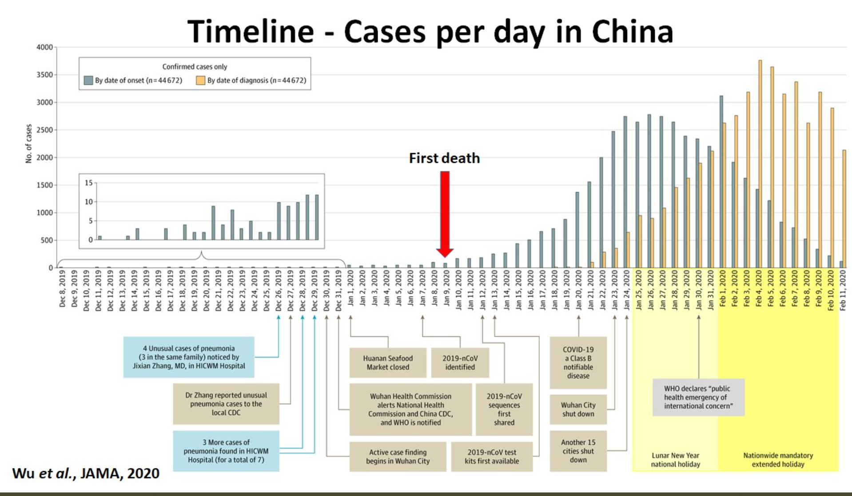
What We Think Happened in Wuhan
China beat it quickly & relatively easily!
We think
Shut down Wuhan when 200 cases per day
That seems to have been a good decision

Slide 31

The Goal
When Is It Appropriate to Move on This?
Immediate social distancing…
Self-isolate if you have a cough and a fever…
Hope that warmer temperatures will do to this what they did to SARS…
Otherwise, when do you want to start spreading out transmission. It seems that early is as good as later, so do it early…
I have no good intuition on why you want to move early
Plus your moving early will be wasted if you get reinfected
Plus the sparks you throw off making others’ lives more difficult

Slide 32
References
Financial Times (2020): Coronavirus Tracked: The Latest Figures as the Pandemic Spreads <https://www.ft.com/coronavirus-latest>
Nick Rowe (2020): Relative Supply Shocks, Unobtainium, Walras' Law, and the Coronavirus <https://worthwhile.typepad.com/worthwhile_canadian_initi/2020/03/relative-supply-shocks-unobtainium-walras-law-and-the-coronavirus.html>
Jim Stock (2020): Coronavirus Data Gaps and the Policy Response <https://drive.google.com/file/d/12MV466ZZy5xHir4xdPhoTrL1oO8CbZU-/view>

Slide 33
MOAR Coronavirus!
What I am watching:
Max Roser & Hannah Ritchie: Coronavirus Disease (COVID-19) <https://ourworldindata.org/coronavirus>…
Worldometer: Coronavirus Update (Live) <https://www.worldometers.info/coronavirus/>: ‘125,599 Cases and 4,605 Deaths from COVID-19 Virus Outbreak…
FT Coronavirus Tracker <https://www.ft.com/content/a26fbf7e-48f8-11ea-aeb3-955839e06441>
Josh Marshall’s COVID Twitter List <https://twitter.com/i/lists/1233998285779632128>
NEJM Group: Updates on the Covid-19 Pandemic <http://m.n.nejm.org/nl/jsp/m.jsp?c=%40kxNtXckRDOq8oG0jJvAXsIzN4mPECIPhltxoTSdTU9k%3D&cid=DM89089_NEJM_COVID-19_Newsletter&bid=173498255>: 'From the New England Journal of Medicine, NEJM Journal Watch, NEJM Catalyst, and other trusted sources...

Slide 34
Catch Our Breath…
Ask a couple of questions?
Make a couple of comments?
Any more readings to recommend?
<https://www.icloud.com/keynote/0YKEi7HeOrVGvKYtt9FEqH7nA>

Slide 35
Coronavirus! (March 16)
With 31 deaths in the U.S. as of March 11, a 1% death rate, and up to 4 weeks between infection and death, that means that as of Feb 12 there were 3100 coronavirus cases in the United States.
With 87 deaths in the U.S. as of Mar 16, a 1% death rate, and up to 4 weeks between infection and death, that means that as of Feb 17 there were 8700 coronavirus cases in the United States
If it is doubling every seven days, then now about 150,000 people have and in the next week about 150,000 more people in the U.S. will catch coronavirus—which means 1/2200, currently 3500 of the 7.6 million inhabitants of San Francisco Bay. Touch a hard surface that any of those 3500 has touched in the last 48 hours, and the virus has a chance to jump to you…
These numbers could be five times too big. These numbers are probably not five times too small unless the thing is a lot less deadly, and there are a lot of asymptomatic cases…
What is wrong with this analysis?

Slide 36


MOAR Coronavirus!
As of March 21: Things are not moving in the right direction:
What is the R0?
How can the R0 be changed?
How will the R0 change?
What is the asymptote share of the population?
What is the mortality rate?

Slide 37


MOAR Coronavirus!
As of March 10: Things are not moving in the right direction:
What is the R0?
How can the R0 be changed?
How will the R0 change?
What is the asymptote share of the population?
What is the mortality rate?

Slide 38
Notes

Slide 39
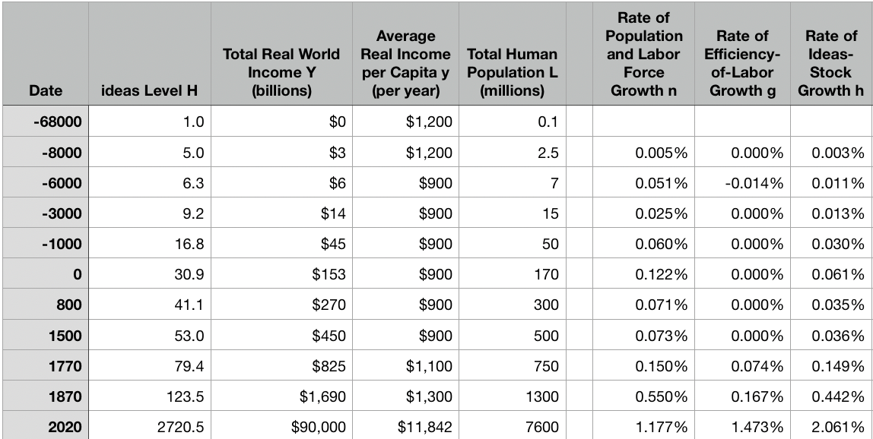
Reviews
Post-1870 is the miracle:

Slide 40
Review: The Broad Sweep
Post-1870 is the miracle:

Slide 41
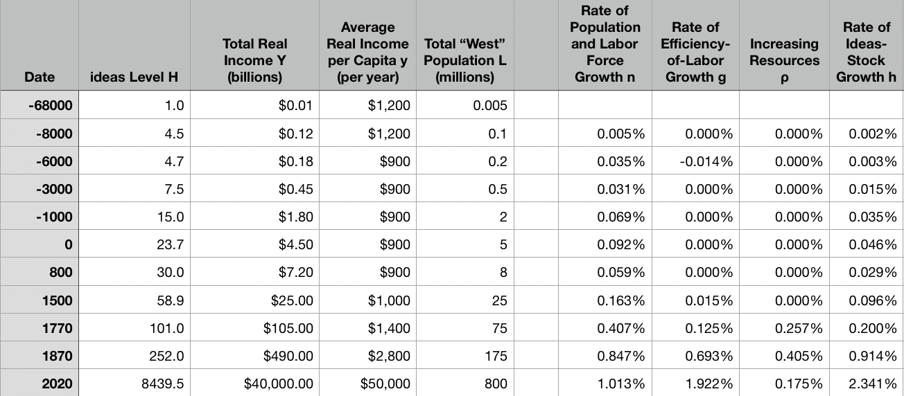
“The West”
800, 1500, 1770, or 1870?:

Slide 42
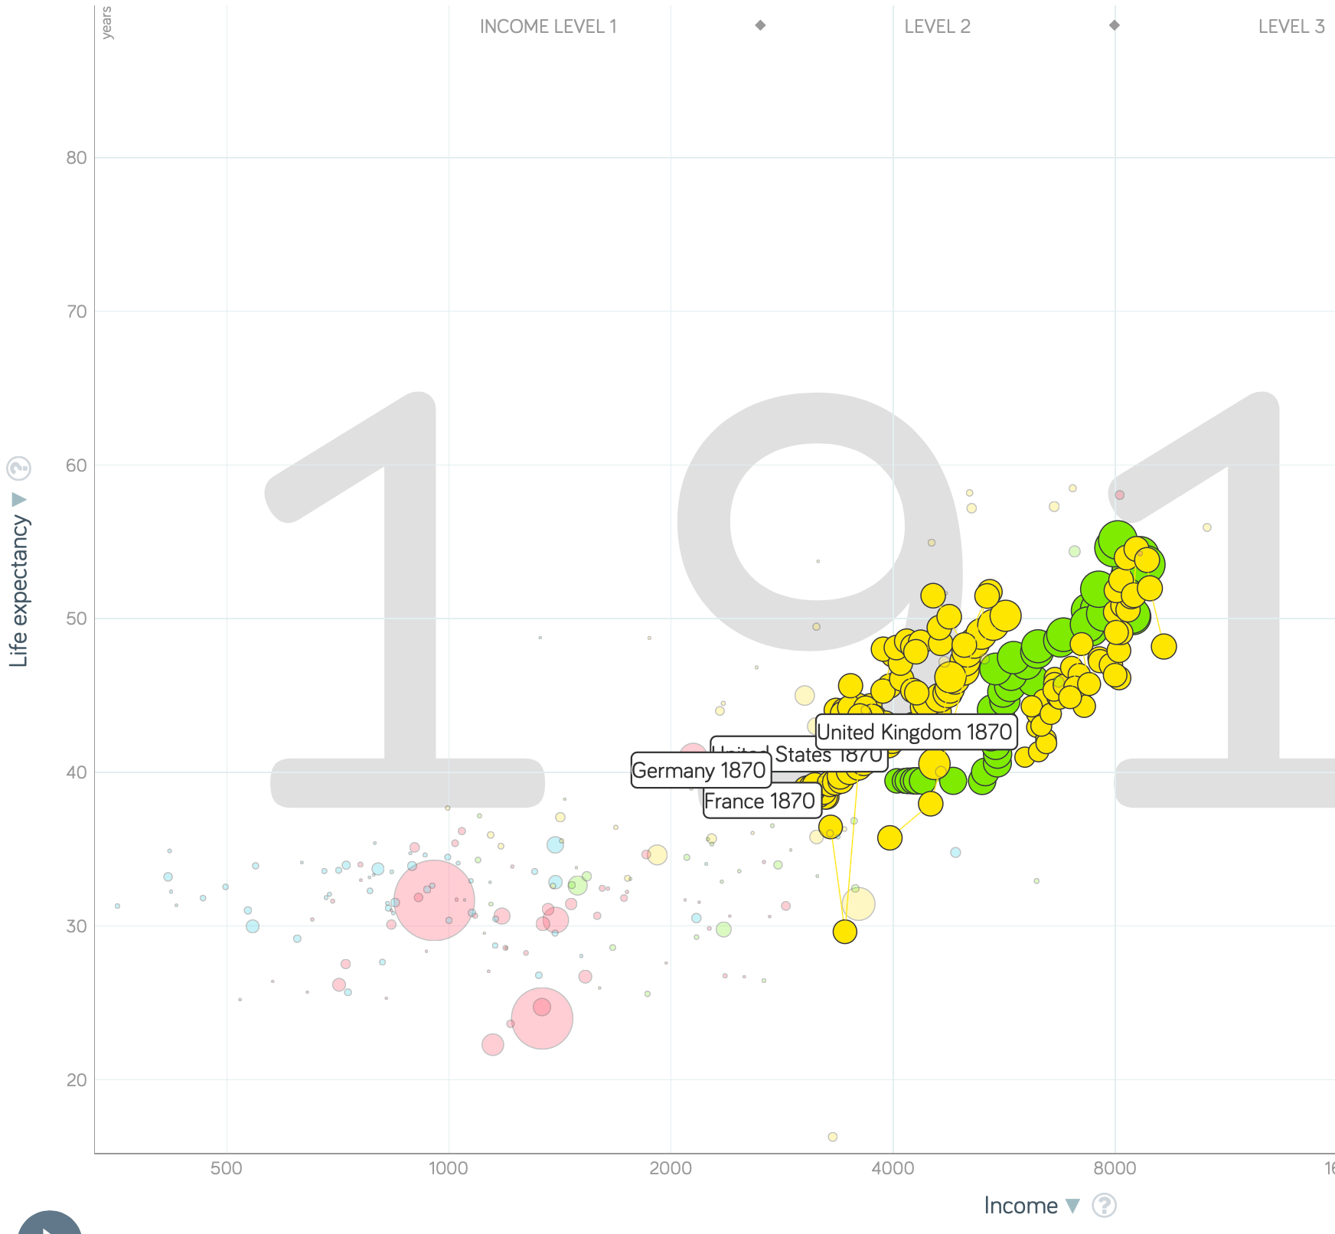
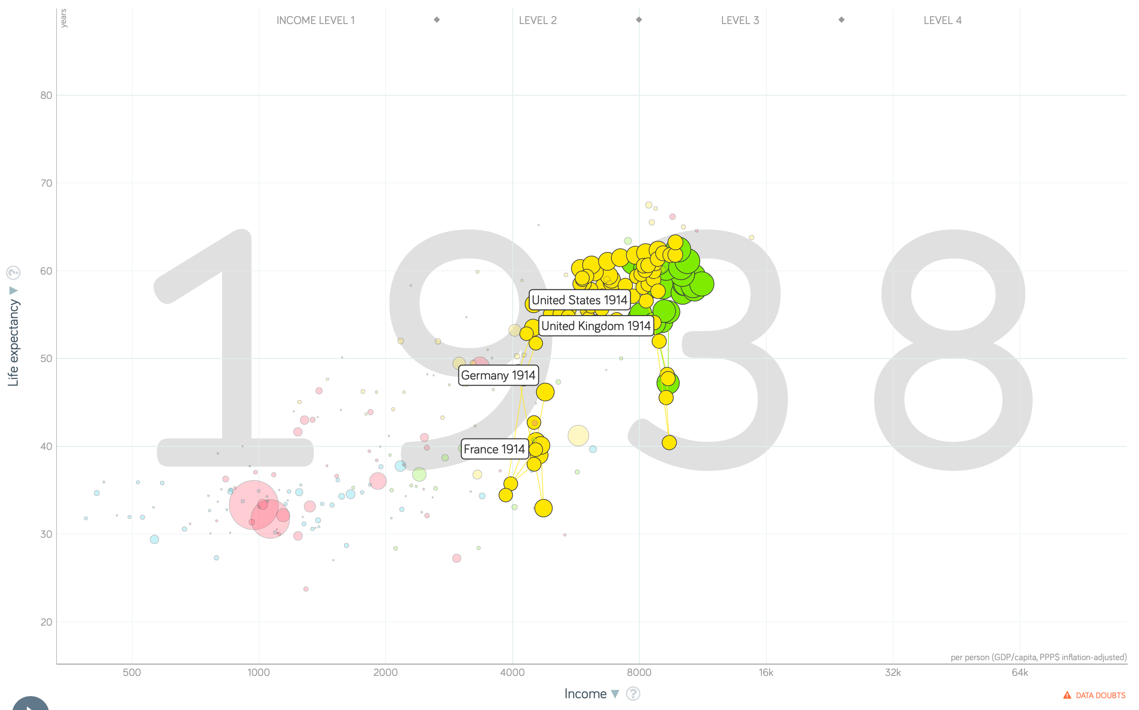
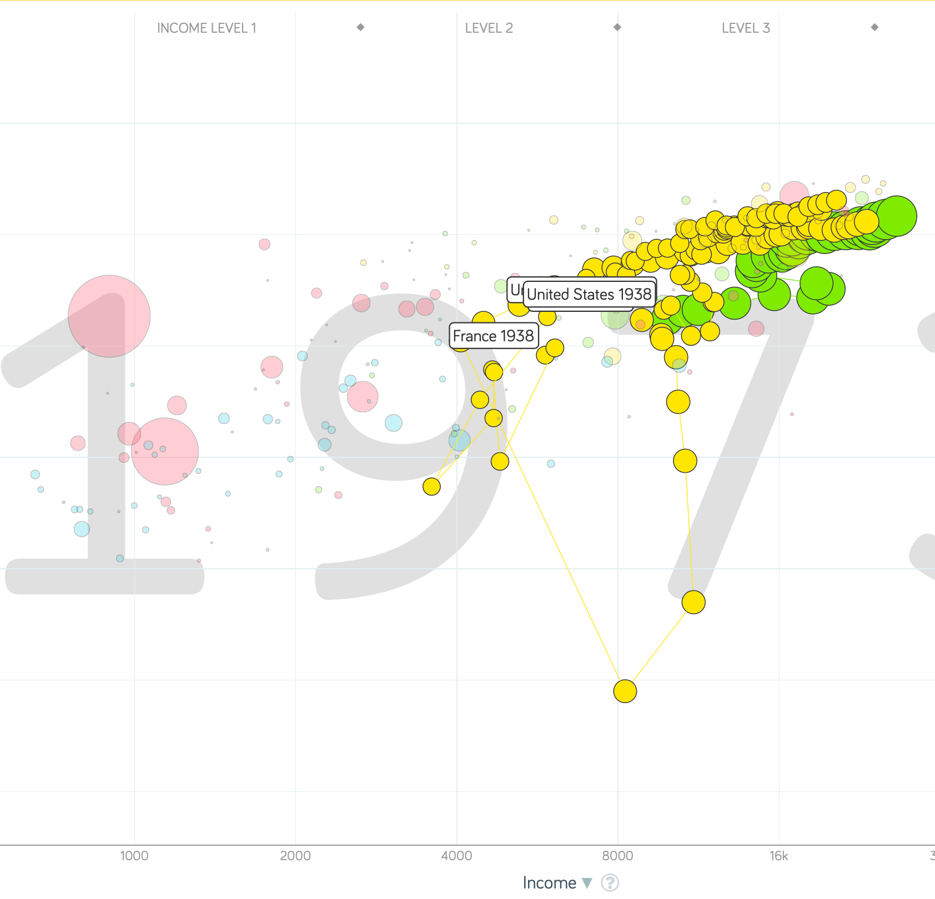
“The West”
1914-1938, 1870-1913, & 1938-1973
Rate of growth in the North Atlantic industrial core halves comparing 1870-1913 to 1914-1938; then triples afterwards over 1938-1973
Slows again after 1973

Slide 43
To Your iClickers
What was the growth rate of ideas in the industrial core of the world economy over 1870-2020?
About 2.3%/year
About 0.9%/year
About 0.23%/year
About 4%/year
None of the above

Slide 44
To Your iClickers
What was the growth rate of ideas in the industrial core of the world economy over 1770-1870?
About 2.3%/year
About 0.9%/year
About 0.23%/year
About 4%/year
None of the above

Slide 45
Review: The Belle Époque Broken
John Maynard Keynes:
“Very few of us realise[d] with conviction the intensely unusual, unstable, complicated, unreliable, temporary nature of the economic organisation by which Western Europe has lived for the last half century. We assume some of the most peculiar and temporary of our late advantages as natural, permanent, and to be depended on, and we lay our plans accordingly.
“On this sandy and false foundation we scheme for social improvement and dress our political platforms, pursue our animosities and particular ambitions, and feel ourselves with enough margin in hand to foster, not assuage, civil conflict in the European family....
“France, Germany, Italy, Austria, and Holland, Russia and Roumania and Poland, throb together, and their structure and civilisation are essentially one. They flourished together, they have rocked together in a war which we, in spite of our enormous contributions and sacrifices (like though in a less degree than America), economically stood outside, and they may fall together…”

Slide 46
Aristocracy & Social Democracy
The aristocrats had rolled the dice:
Europe in 1914 was a Europe of national populations, of industrialists and socialists, of factory workers and technicians…
Europe’s governments in 1914—especially the defense and foreign affairs ministries—had been populated by aristocrats, ex-aristocrats, and would-be aristocrats.
Landed, aristocratic, military elites had control of many of the levers of propaganda and power…
Aristocrats had had help. Industrialists and entrepreneurs were eager to provide their political support in return for economic benefits, as in the 1879 German “marriage of iron and rye”: the imposition of tariffs on imports of British steel (to protect the positions of German manufacturers) and on imports of American grain (to protect the positions of German landlords)…
On the eve of World War I, these landed military service aristocrats, ex-aristocrats, and would-be aristocrats increasingly found themselves members of a social caste that had no societal function…
But power—in the form of office and of vast (if declining relative) wealth—and propaganda—in the form of pageantry and the press—were reinforced by ideologies: Social darwinism…
The aristocrats rolled the dice—and lost…
Social democrats picked up the chips:
Expanded suffrage…
Proportional representation…
“Lands fit for heroes…”
How to provide for the benefits politicians promised?

Slide 47
Reparations, Taxes, and Inflation
Reparations
A peace “without annexations and indemnities”…
But not without reparations…
Two years’ of Germany’s national income demanded:
Much of it “boob bait for the bubbas…” on the part of Allied politicians…
But a powerful shaper of post-WWI Germany
Taxes
High and progressive tax rates…
A powerful impact on inequality…
Class war…
Inflation
U.S.: price level x1.5
Britain: price level x2.0
France: price level x7.0
French government had encouraged investment in Russian bonds…
German: price level x1,000,000,000,000
Austria, Hungary, Czechoslovakia the same…

Slide 48
Keynes’s Protest
Jan Christian Smuts:
“Poor Keynes often sits with me at night after a good dinner and we rail against the world and the coming flood. And I tell him that this is the time for Grigua’s prayer (the Lord to come himself and not to send his Son, as this is not a time for children). And then we laugh, and behind the laughter is [Herbert] Hoover’s horrible picture of thirty million people who must die unless there is some great intervention. But then again we think that things are never really as bad as that; and something will turn up, and the worst will never be. And somehow all these phases of feeling are true and right in some sense…”

Slide 49
Keynes’s Protest II
John Maynard Keynes:
“If we aim deliberately at the impoverishment of Central Europe, vengeance, I dare predict, will not limp. Nothing can then delay for long that final civil war between the forces of reaction and the despairing convulsions of revolution, before which the horrors of the late German war will fade into nothing, and which will destroy... the civilization and progress of our generation…”

Slide 50
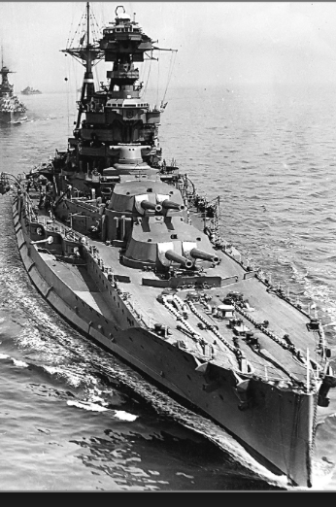
Review: World War I
Nationalism
Max Weber: “The vulgar conception of political economy is that it consists in working out recipes for making the world happy.… However… elbow-room… can [only] be won… through the hard struggle.... That standard of value adopted by a German economic theorist, can… be nothing other than a German policy and a German standard.... Our successors will... hold us responsible... for the amount of elbow-room we conquer.... The science of political economy is... a servant of... the lasting political-power interests of... our nation's power, and the vehicle of that power, the German national state…”
Erich von Manstein: von Manstein, von Lewinsky, Lewinski, Levi…
“We offered 4 battleships a year, the navy demanded 6, and we compromised at 8”

Slide 51
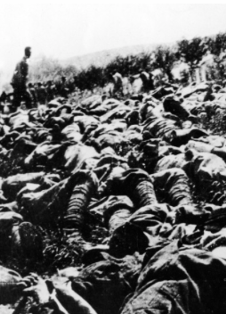
The Catastrophe of World War I: Origins
In the summer of 1914 the empires of Russia and Austria-Hungary are skirmishing diplomatically and threatening each other militarily about the latest Balkan crisis
Began when in the summer of 1914 the Archduke Franz Ferdinand and his wife Sophie were assassinated in Sarajevo
By terrorists with very close links to the intelligence service of the Kingdom of Serbia
What would Austria’s response be?
And then Germany attacks Belgium
And then Australia attacks Turkey

Slide 52
The Catastrophe of World War I: Causes
Why?: “If there is a war, let it come now…”
Russia thought it would have to fight Germany someday, and might as well while France was interested…
Austria, France, Britain (as a result of the German battle fleet) the same
“Busy giddy minds with foreign quarrels…”
A wiser man: Otto von Bismarck:
“There is nothing in the Balkans worth the bones of a single Pomeranian grenadier…”

Slide 53
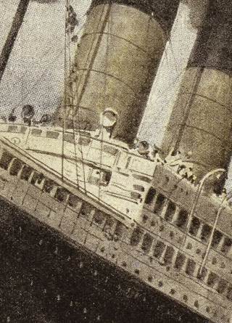
How Does the U.S. Get Involved?
British policy: binding the U.S. upper class to Britain since the 1840s
The Law of the Sea
Neutrals
Blockade
The submarine
Unrestricted submarine warfare
Zimmerman Telegram
Woodrow Wilson
“Teach the Mexicans to elect good men…”
“The war to end war…”

Slide 54
The Catastrophe of World War I: Outcome—Human
Combatants had mobilized 65M out of 100M men of military age
10M killed
10M maimed
Civilian casualties less than 10% of military
Costs of 1.5x a year’s GDP
Plus a 15M global flu epidemic
Russian, Austro-Hungarian, German, Ottoman Turkish Empires all gone…
Representative governments destabilized—or weak…
The Russian Revolution…
Hungarian, Bavarian socialist republics (short-lived)
Spartakist…
Allies demand 2 years of German GDP as “reparations”…

Slide 55
Catch Our Breath…
Comments?
Questions?

Slide 56

Review: Edward Bellamy: Looking Backward
Edward Bellamy: Looking Backward <https://delong.typepad.com/files/bellamy-backward.pdf>: Perhaps the third best-selling novel of the 19th century in the United States
2000 is a utopia…
The narrator is carried forward in time from 1887-2000 by an implausible plot device:
‘“This is the tenth day of September in the year 2000, and you have slept exactly one hundred and thirteen years, three months, and eleven days…”’
He then wanders around, looking at the utopia of 2000…
The opening:
‘“How could I live without service to the world?” you ask…. The answer is that my great-grandfather had accumulated a sum of money on which his descendants had ever since…. The sum had been originally by no means large. It was, in fact, much larger now that three generations had been supported upon it in idleness, than it was at first…’

Slide 57
The Stagecoach of Society
Those who ride and this who pull:
‘Commiseration was frequently expressed by those who rode for those who had to pull the coach, especially when the vehicle came to a bad place in the road, as it was constantly doing, or to a particularly steep hill. At such times, the desperate straining of the team, their agonized leaping and plunging under the pitiless lashing of hunger, the many who fainted at the rope and were trampled in the mire, made a very distressing spectacle, which often called forth highly creditable displays of feeling on the top of the coach.
‘At such times the passengers would call down encouragingly to the toilers of the rope, exhorting them to patience, and holding out hopes of possible compensation in another world for the hardness of their lot, while others contributed to buy salves and liniments for the crippled and injured. It was agreed that it was a great pity that the coach should be so hard to pull, and there was a sense of general relief when the specially bad piece of road was gotten over. This relief was not, indeed, wholly on account of the team, for there was always some danger at these bad places of a general overturn in which all would lose their seats.
‘It must in truth be admitted that the main effect of the spectacle of the misery of the toilers at the rope was to enhance the passengers’ sense of the value of their seats upon the coach, and to cause them to hold on to them more desperately than before…

Slide 58
The Stagecoach of Society II
“Finer clay”:
‘The other fact is yet more curious, consisting in a singular hallucination which those on the top of the coach generally shared, that they were not exactly like their brothers and sisters who pulled at the rope, but of finer clay, in some way belonging to a higher order of beings who might justly expect to be drawn. This seems unaccountable, but, as I once rode on this very coach and shared that very hallucination, I ought to be believed.
‘The strangest thing about the hallucination was that those who had but just climbed up from the ground, before they had outgrown the marks of the rope upon their hands, began to fall under its influence. As for those whose parents and grand-parents before them had been so fortunate as to keep their seats on the top, the conviction they cherished of the essential difference between their sort of humanity and the common article was absolute. The effect of such a delusion in moderating fellow feeling for the sufferings of the mass of men into a distant and philosophical compassion is obvious.
‘To it I refer as the only extenuation I can offer for the indifference which, at the period I write of, marked my own attitude toward the misery of my brothers…

Slide 59
The Stagecoach of Society III
Class war:
‘The sanguine argued very forcibly that it was in the very nature of things impossible that the new hopes of the workingmen could be satisfied, simply because the world had not the wherewithal to satisfy them. It was only because the masses worked very hard and lived on short commons that the race did not starve outright, and no considerable improvement in their condition was possible while the world, as a whole, remained so poor.
‘It was not the capitalists whom the laboring men were contending with, these maintained, but the iron-bound environment of humanity, and it was merely a question of the thickness of their skulls when they would discover the fact and make up their minds to endure what they could not cure.
The less sanguine admitted all this. Of course the workingmen’s aspirations were impossible of fulfillment for natural reasons, but there were grounds to fear that they would not discover this fact until they had made a sad mess of society. They had the votes and the power to do so if they pleased, and their leaders meant they should. Some of these desponding observers went so far as to predict an impending social cataclysm. Humanity, they argued, having climbed to the top round of the ladder of civilization, was about to take a header into chaos…’

Slide 60
The Limit of Human Felicity I
In the music room:
‘She made me sit down comfortably, and, crossing the room, so far as I could see, merely touched one or two screws, and at once the room was filled with the music of a grand organ anthem; filled, not flooded, for, by some means, the volume of melody had been per- fectly graduated to the size of the apartment. I listened, scarcely breathing, to the close. Such music, so perfectly rendered, I had never expected to hear.
‘“Grand!” I cried, as the last great wave of sound broke and ebbed away into silence. “Bach must be at the keys of that organ; but where is the organ?”…
‘“There are a number of music rooms in the city, perfectly adapted acoustically to the different sorts of music. These halls are connected by telephone with all the houses of the city…. Any one of the four pieces now going on that you prefer, you can hear by merely pressing the button which will connect your house-wire with the hall where it is being rendered…”’

Slide 61
The Limit of Human Felicity III
Four live orchestras you can listen to on the speakerphone!
‘“It appears to me, Miss Leete,” I said, “that if we could have devised an arrangement for providing everybody with music in their homes, perfect in quality, unlimited in quantity, suited to every mood, and beginning and ceasing at will, we should have considered the limit of human felicity already attained, and ceased to strive for further improvements…”’

Slide 62
Review: The View from 3000: Themes & Big Ideas
Science reaches critical mass and from it springs engineering—all of the engineering subdisciplines, including the management of human resources and of organizations. From a liberal political order spring national and then the global market economy. And from engineering and the market, and the large bureaucratic corporation then, over the course of 1870-2016, spring…
History was economic…
Explosion of wealth…
Cornucopia of technology…
Demographic transition…
Feminist revolution…
Inclusion and hierarchy attenuation…
Empowered tyrannies…
Wealth gulfs…
Mismanagement and insecurity…

Slide 63
Measuring Growth
What are my estimates of the rate of growth of economically-useful human knowledge over 1-1500, 1500-1800, 1800-1870, and 1870-2000?
0.02%/year, 0.2%/year, 0.5%/year, and 0.8%/year
0.000%/year, 0.02%/year, 0.2%/year, and 0.8%/year
0.02%/year, 0.2%/year, 0.8%/year, and 2.3%/year
0.2%/year, 0.8%/year, 2.3%/year, and 4.7%/year
None of the above.

Slide 64
What Is the Key Factor in the Explosion of Wealth in the 20th Century?
Yes, many things contributed. But suppose you have to pick just one

Slide 65
What Are the Four Factors That I See as Making for the Explosion of Wealth in the 20th Century?
Yes, there are many, many more things that contributed. But suppose you have to pick just four:

Slide 66
Demography II
What is the principal cause of the demographic transition?
Female wealth and control of property.
Female literacy.
Falling infant and child mortality.
Land shortages and high unemployment.
Something else.

Slide 67
Feminism
How many pregnancies do we think Abigail Smith Adams had between when she was 20 and 34?
2.
4.
6.
8.
18.

Slide 68
Empowered Tyrannies II
How many world leaders are members of the 10-million club?
2.
4.
6.
8.
18.

Slide 69
Inclusion and Hierarchy Attenuation
At the start of the 1970s, future President Ronald Reagan said that diplomats from Tanzania appeared uncomfortable:
resisting pressure to vote with the Soviet Union at the United Nations.
making small talk with New York socialites.
wearing shoes.
in formal tuxedos.
None of the above.

Slide 70
Economic Mismanagement and Insecurity II
According to Karl Polanyi, what rights does the market economy respect?
rights to land (a stable community).
rights to labor (a “just” income).
rights to finance (a stable economic place).
rights to property (the ability to keep what you manage to claim to earn).
None of the above.

Slide 71
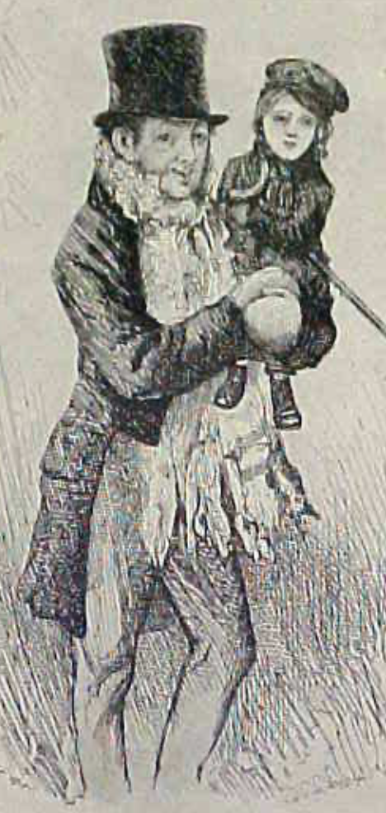
Review: The Watershed: 1870 as an Inflection Point
As of 1870, had the Industrial Revolution raised the standard of living or lightened the toil of the working class in England, the country at its center?
Yes
No
It’s not clear
Why? Malthusian forces—population explosion & thus smaller farm sizes. Growth, the growth had been slow 0.8%/year?

Slide 72
Globalization
Who called the era of globalization and growth from 1870 to 1914 an “economic El Dorado”?
Karl Marx
John Stuart Mill
Thomas Robert Malthus
John Maynard Keynes
None of the above
What would the others have said?

Slide 73
Migration
How many people of the roughly 1.5 billion then-population of the world left their continents of origin between 1870-1913?
10 million
50 million
100 million
200 million
400 million

Slide 74
Before 1870, Ideas Growth Not Fast Enough
And population growth accelerates as the world is not rich enough to undergo the demographic transition:
Value of useful and deployed ideas about technology and organization
-8000: 1
1: 3.5
1500: 4.75
1800: 9
1870: 16
2020: 421
Growth Rates:
-8000 to 1500: 0.02%/year
1500 to 1800: 0.2%/year
1800 to 1870: 0.8%/year
1870 to 2020: 2.3%/year
What caused these accelerations? What caused this last acceleration?

Slide 75
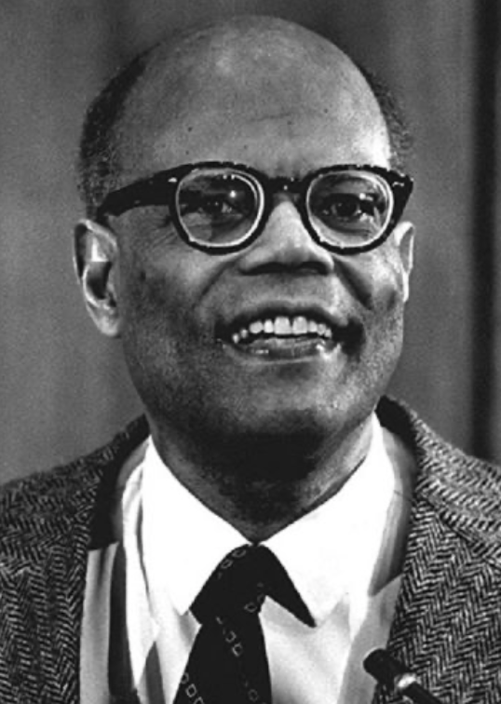
The Last Acceleration
The industrial research lab to routinize invention, and the modern corporation to routinize diffusion and deployment
Plus general purpose technologies—machine tools, non-human power sources
Arthur Lewis:
“New commodities: telephones, gramophones, typewriters, cameras, automobiles, and so on, a seemingly endless process whose latest twentieth-century additions include aeroplanes, radios, refrigerators, washing machines, television sets, and pleasure boats. Thus a rich man in 1870 did not possess anything that a rich man of 1770 had not possessed; he might have more or larger houses, more clothes, more pictures, more horses and carriages, or more furniture than say a school teacher possessed, but as likely as not his riches were displayed in the number of servants whom he employed rather than in his personal use of commodities…”
Not so much the particular technologies, as the grasping of the fact that there was a broad and deep range of new technologies to be discovered.
As much as it was new technologies, it was large-scale corporate organizations that could and did plan the division of labor to make use of and then market technologies.
And as much, it was that the global market meant that there was now a great deal of money to be made from the routinization of the exploration, development, and deployment of technological possibilities

Slide 76
Worldwide: The Broad Sweep
Post-1870 is the miracle:

Slide 77
“The West”
800, 1500, 1770, or 1870?:

Slide 78
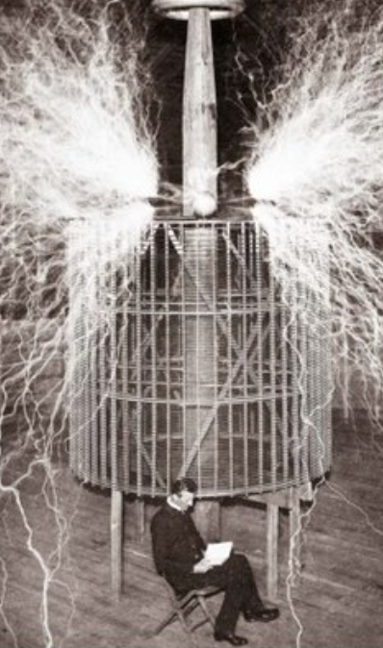
Who Is This Man?
And is he in any real danger?
Thomas Edison, and no
Andrew Carnegie, and no
Nicola Tesla, and no
Thomas Edison, and yes
Herbert Hoover, and yes

Slide 79
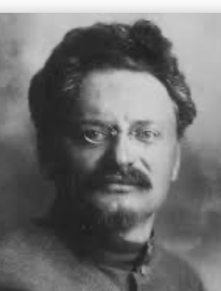
Lev Bronstein
Why did he say this?
“I had had no time to more than catch the general life-rhythm of the monster known as New York…”
“I left for Europe with the feeling of a man who has had only a peek into the furnace where the future is being forged…"

Slide 80
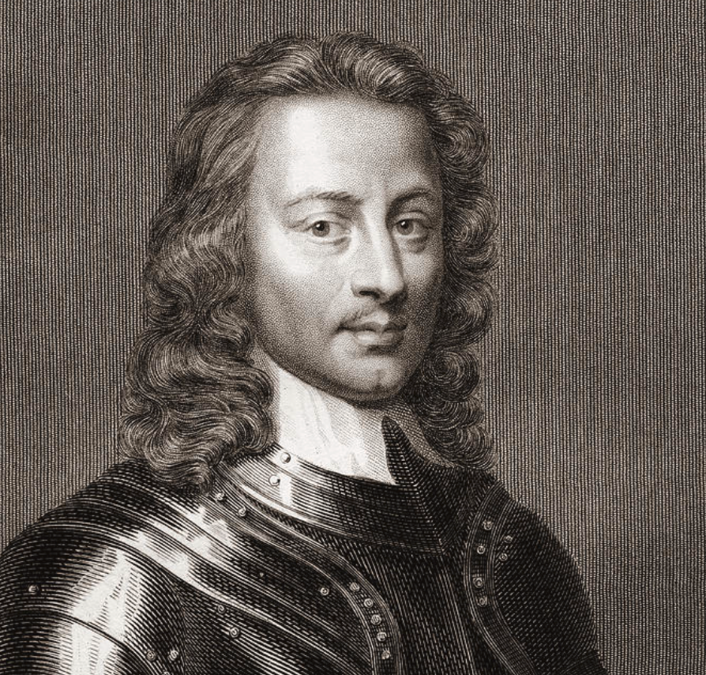
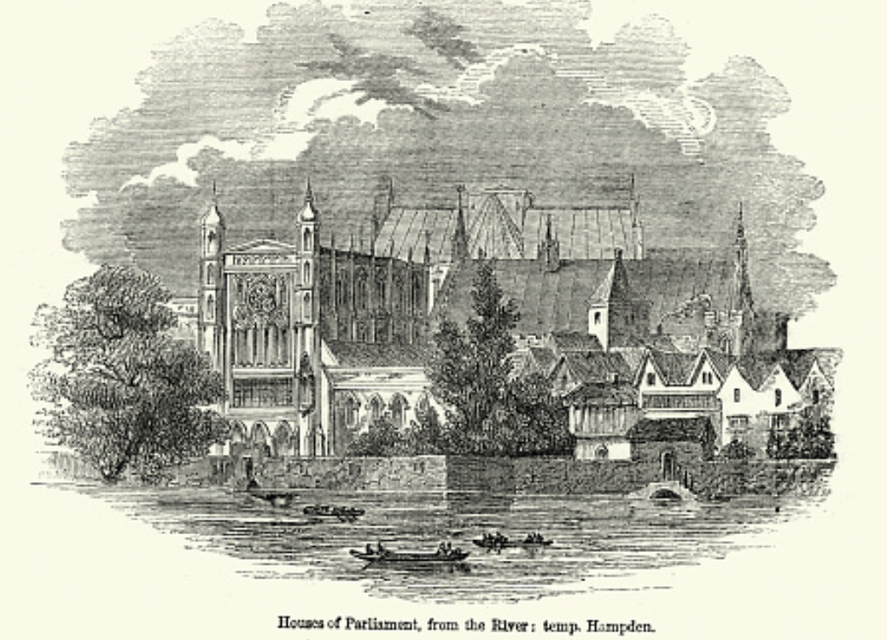
Review: Political Economy
From “Divine Right” and “Natural Order” to Enlightenment values…
Who was the first person to draft these words:?
“We hold these truths to be sacred & undeniable:
that all men are created equal & independant,
that from that equal creation they derive rights inherent & inalienable,
among which are the preservation of life, & liberty, & the pursuit of happiness;
that to secure these ends, governments are instituted among men, deriving their just powers from the consent of the governed…”
John Locke
Niccolo Machiavelli
Thomas Hobbes
Thomas Jefferson
George Washington
Why did he write them?

Slide 81
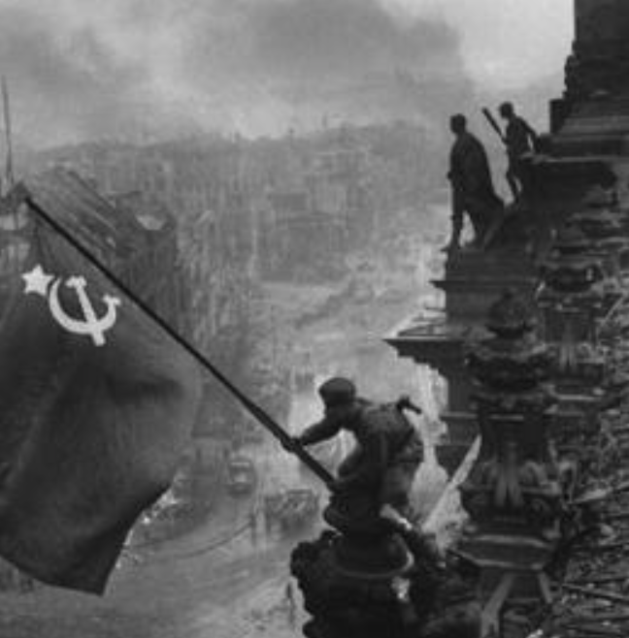
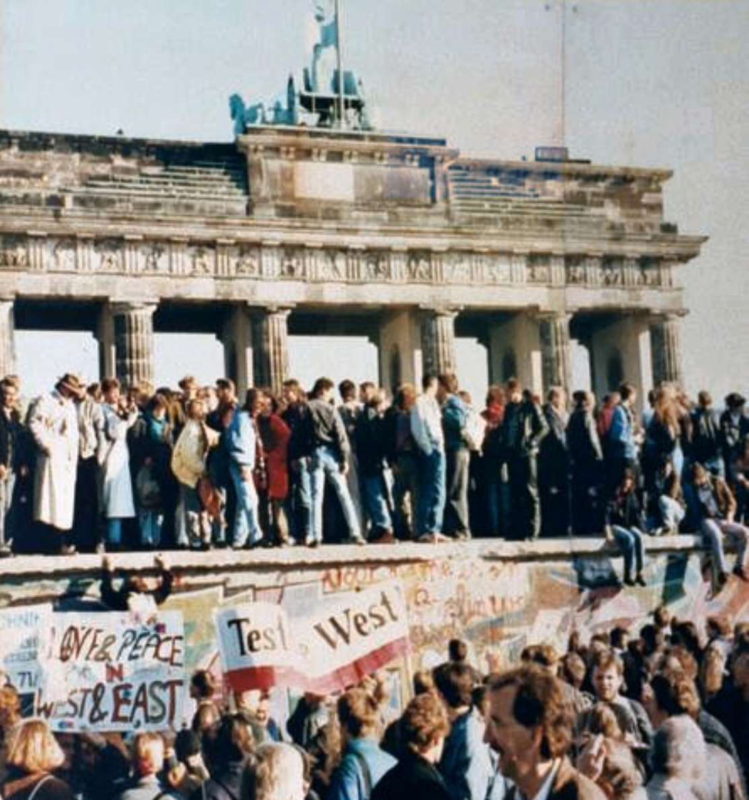
What Was the Proper Political Order?
Fears of “democracy” among American founders:
Madison: “Democracies have ever been spectacles of turbulence and contention... incompatible with personal security or the rights of property... as short in their lives as... violent in their deaths…”
Jefferson: “Gen’l Washington had not a firm confidence in the durability of our government… [& this] had some weight in his adoption of… ceremonies… calculated to prepare us gradually for a change which he believed possible…”
Hamilton: “the British government… best” as the only one “unit[ing] public strength with individual security…”
Adams: The American president should be announced as: “His Highness, the President of the United States, and Protector of the Rights of the Same…”
Question of political order thought settled: first in the rubble of Berlin in 1945, and then in the streets of East Germany in 1991:
Settled in favor of representative democracy, private property, & social insurance—late-1900s liberal democracy
But now reopened? Min Zhu (朱民) to me in 2015: “What are you Americans going to do to fix your broken political system?”

Slide 82
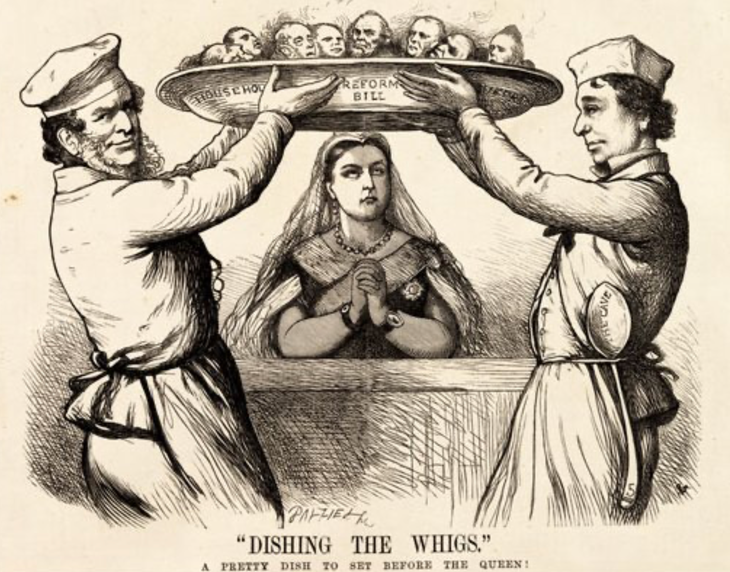
Franchise Restricted to the Rich Could Not Maintain Itself
The dynamic of franchise extension
Liberals in power would try extend on the principle that the new, poorer voters would be less conservative and would support them.
Threatening revolution would lead even conservatives to seek to extend the franchise in order to peel off of the revolutionary coalition those of the disenfranchised who had the most social power:
Earl Grey (yes, the tea): “The Principal… is to prevent… revolution…. I am reforming to preserve, not to overthrow…”
Charismatic leaders with popular followings would seek to give them votes, and then rule via plebiscites—going around the traditional elites
(Peculiar thing about Trump-Johnson: minority, and core is a minority of a minority…)
Conservatives: “dish the Whigs”—opportunities to form winning coalitions by appealing to those who were no profiting from the market economy, or felt that they were losing relative status in some ways…

Slide 83
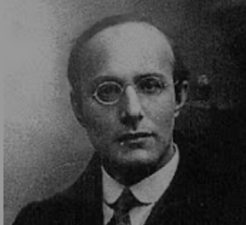
Popular Government and the Market Economy: Society’s Revenge
Karl Polanyi
People believe they have rights—to stable, supportive, nurturing communities; to incomes commensurate with their skills and status; and to money flows that will provide economic stability…
But a market society turns these things—land, labor, and finance—into commodities…
But they are not real commodities, they are fictitious commodities
And so you get your rights only if they satisfy a market profitability test
The only rights a market society respects are property rights:
& the only property rights that are worth anything are those that help you produce things for which rich people have a serious jones
Society will have its revenge: it will protect itself against the market logic, somehow, some way…

Slide 84
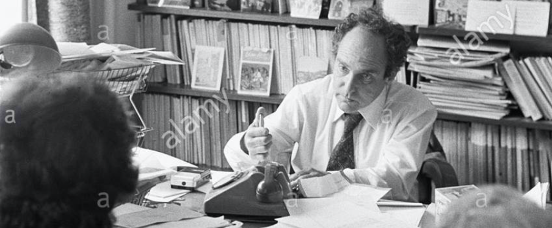
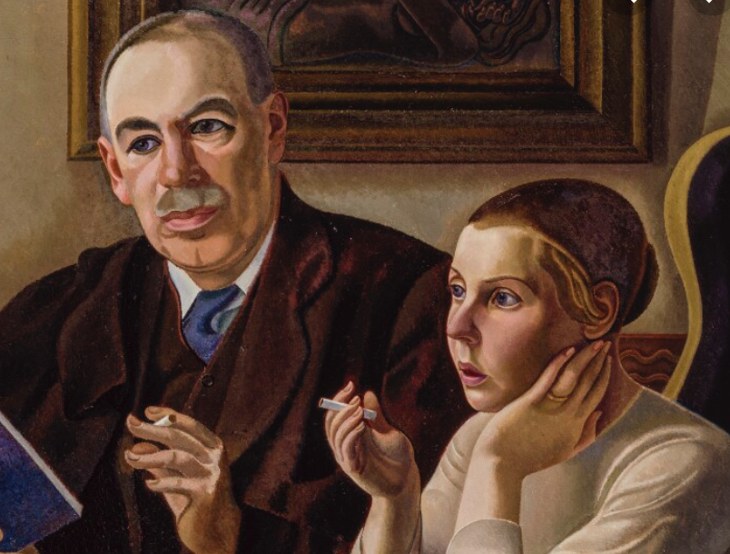

Digression: 5 Thinkers
Who shape my thought about the long 20th century—and how should, I think, shape yours
Beware! They are all deeply flawed…
But they are also geniuses, each in his way…
Beware of their followers! An iron law of ideology: a thinker’s most extravagant and aggressive followers will latch onto the stupidest and most shortsighted and wrong of their doctrines…
In historical order: Marx, Keynes, Hayek, Polanyi, Gellner
The other three thinkers:
Keynes: All that we need to produce general prosperity is technical adjustments to our system. Then the kingdom of freedom and prosperity will be within our grasp—and our major problems will no longer be economic ones
Gellner: The energy that most 19th century thinkers thought would go to “class“ went to “ethnos“ or “umma“ instead. The construction of ideological legitimations that makes sense both to dominants and to submissives who nevertheless believe they are part of some in-group is the key to understanding how societies stabilize themselves
Marx: Only the market economy will focus society’s energy on paying through the nose to boost the economy’s capital stock and to harvest the fruits of science and technology and then deploy them in production. But because the only demands in a market economy that matter are effective demands, the market economy also becomes a more “effective” means of slavery, for private property leads the proletariat to enslave themselves

Slide 85
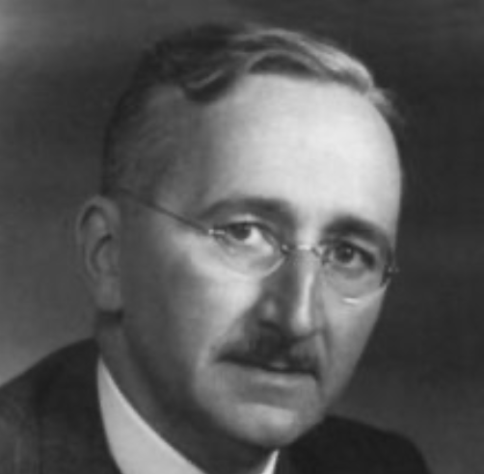
Hayek and Polanyi
Thumbnails on our first two:
Hayek:
Only the market economy can use society’s knowledge.
But the market economy cannot produce “social justice” and should not be asked to try—in fact, we need to recognize that all we can attain is freedom, and that will bring general prosperity, but that justice will be forever outside our reach
Polanyi:
The market economy turns land, labor, and finance into “fictitious commodities”
Society will have its revenge via a “double movement”

Slide 86
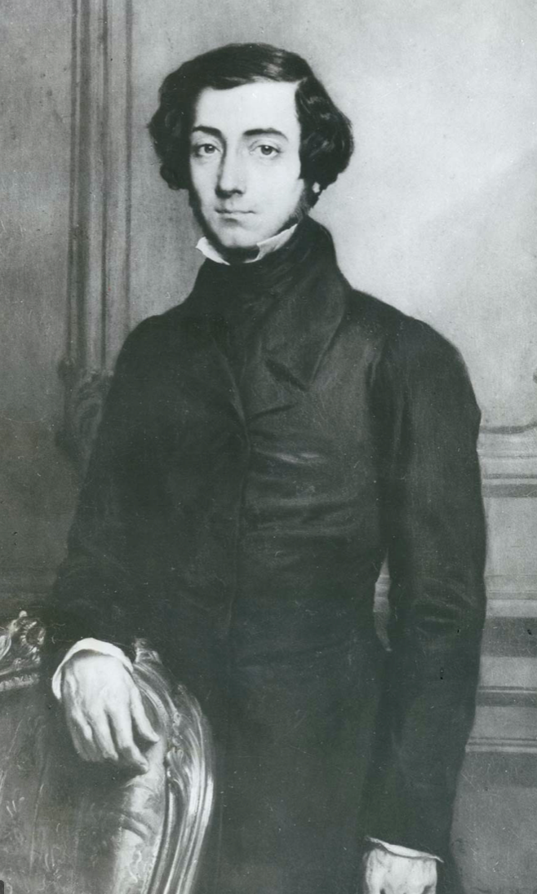
Plus Tocqueville
Toqueville on the rich as “elder brothers” in 1848:
“In the country all the landed proprietors, whatever their origin, antecedents, education or means, had come together, and seemed to form but one class: all former political hatred and rivalry of caste or fortune had disappeared from view. There was no more jealousy or pride displayed between the peasant and the squire, the nobleman and the commoner; instead, I found mutual confidence, reciprocal friendliness, and regard. Property had become, with all those who owned it, a sort of badge of fraternity. The wealthy were the elder, the less endowed the younger brothers; but all considered themselves members of one family, having the same interest in defending the common inheritance. As the French Revolution had infinitely increased the number of land-owners, the whole population seemed to belong to that vast family. I had never seen anything like it, nor had anyone in France within the memory of man…”
“The territorial aristocracy of past ages… [was] obliged… to come to the help of its servants and relieve their distress” no such reciprocal ties of obligation bound the aristocrats of manufactures to their workers: thus “the manufacturing aristocracy which we see rising before our eyes is one of the hardest that have appeared on the earth…”

Slide 87
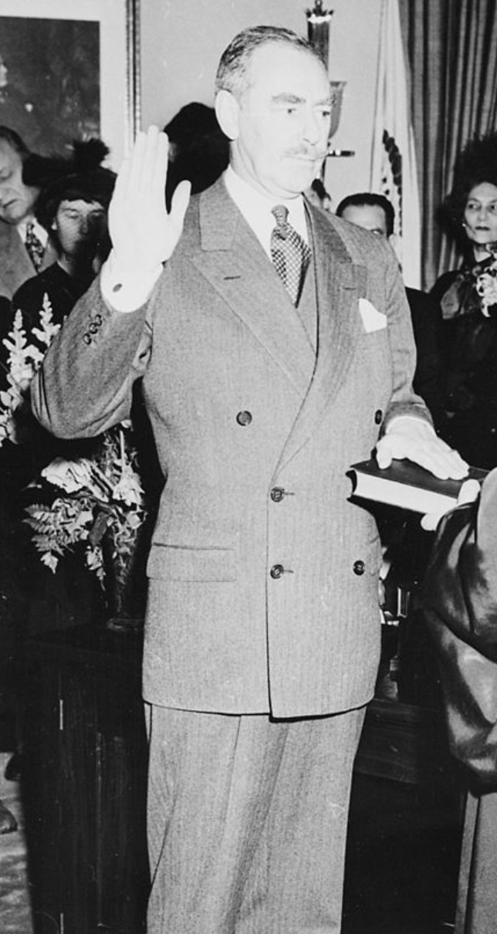
Plus Acheson
Dean Acheson, Secretary of State for Harry S Truman:
On the Republican Party as the party of wealth, enterprise, and opportunity:
“This business base of the Republican Party is stressed not in any spirit of criticism. The importance of business is an outstanding fact of American life. The achievements of business have been phenomenal. It is altogether appropriate that one of the major parties should represent its interests and its point of view…”
The subsequent transformation of the Republican Party from those who were going to become millionaires, or become even greater millionaires; to those who fear that they would lose it all…

Slide 88
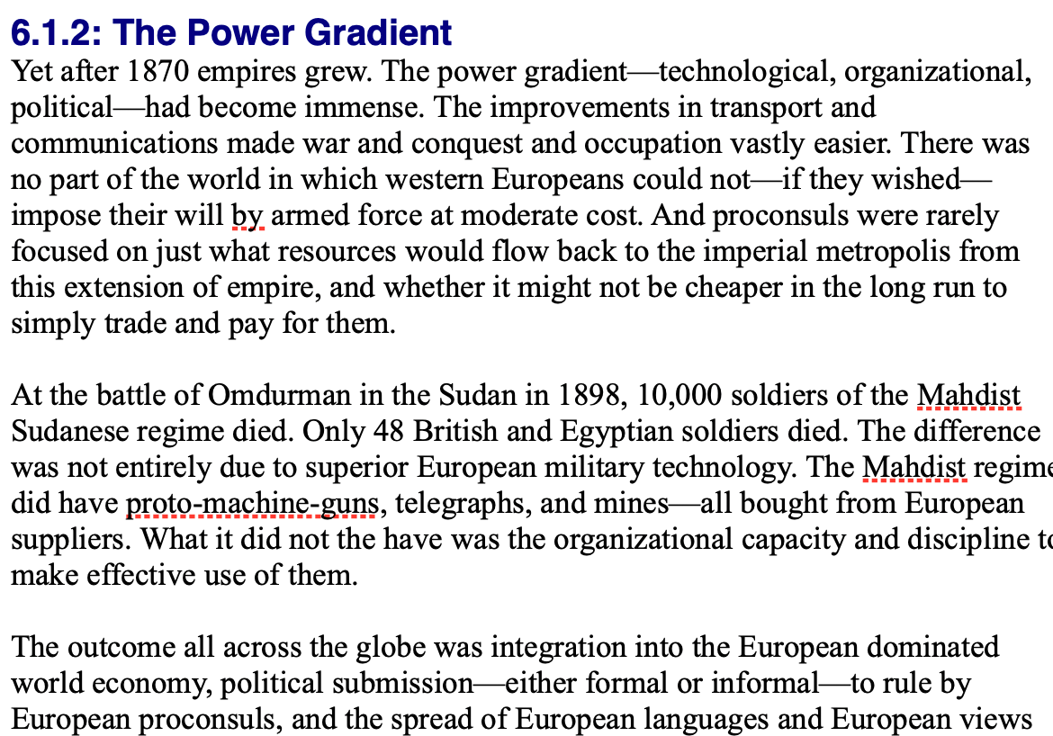
Review: Empire
By 1810 the tide of empire had been clearly ebbing…
But then things turned around: the power gradient:

Slide 89
To Your iClickers!
According to Eichengreen, graphing international capital flows and mobility since 1850 over time produces a graph that is:
V-shaped
U-shaped
W-shaped
An upward line
None of the above

Slide 90
To Your iClickers!
According to Eichengreen, the responsibilities of a pre-World War I central bank as steward of the global gold standard and also as lender-of-last-resort in domestic financial crises were:
in complete harmony
in irresolvable tension
for the most part manageable, before World War I at least, via fancy footwork and good luck
not understood
none of the above

Slide 91
To Your iClickers!
According to Eichengreen, the experience of being on the gold standard for North Atlantic economies in the 1870-1914 period was by and large a happy one, and the experience of countries at the world economy’s periphery was:
also by and large a happy one.
a mixed one.
a source of considerable tension, instability, and political upset.
once again, manageable with fancy footwork and a little good luck.
none of the above.

Slide 92
To Your iClickers!
In Eichengreen’s view, if World War I had somehow been avoided, would the global gold standard have remained stable in the 1920s and 1930s?
There are no guarantees, but probably yes.
There are no guarantees, but probably no.
Certainly not!
Certainly yes—unless several North Atlantic economies experienced a socialist revolution
None of the above.

Slide 93
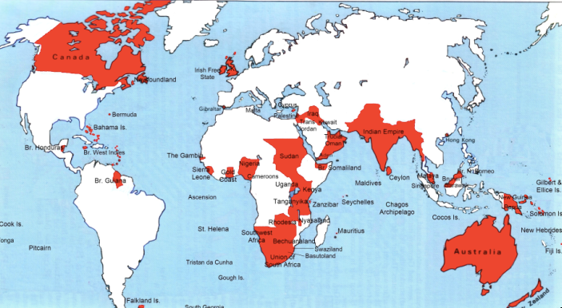
Empire

Slide 94
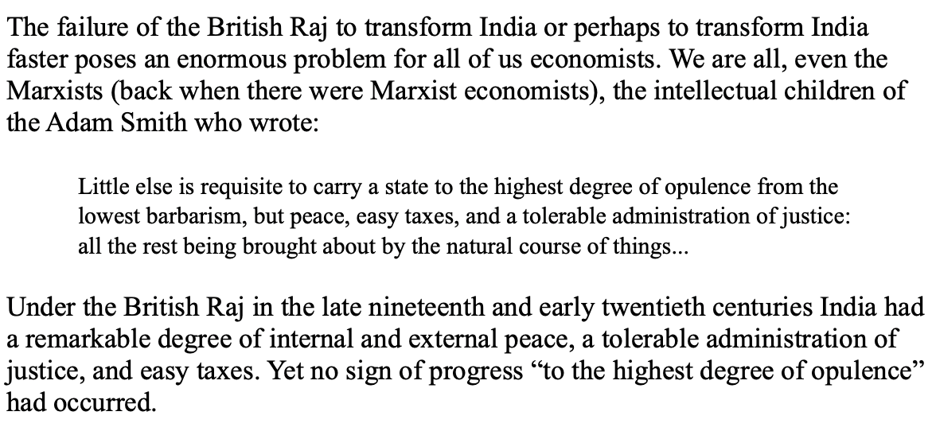
India
Why didn’t the British transform India into an industrial power?

Slide 95
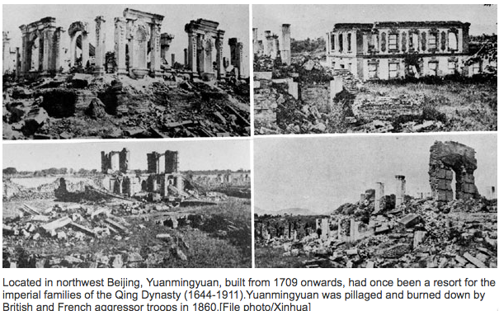
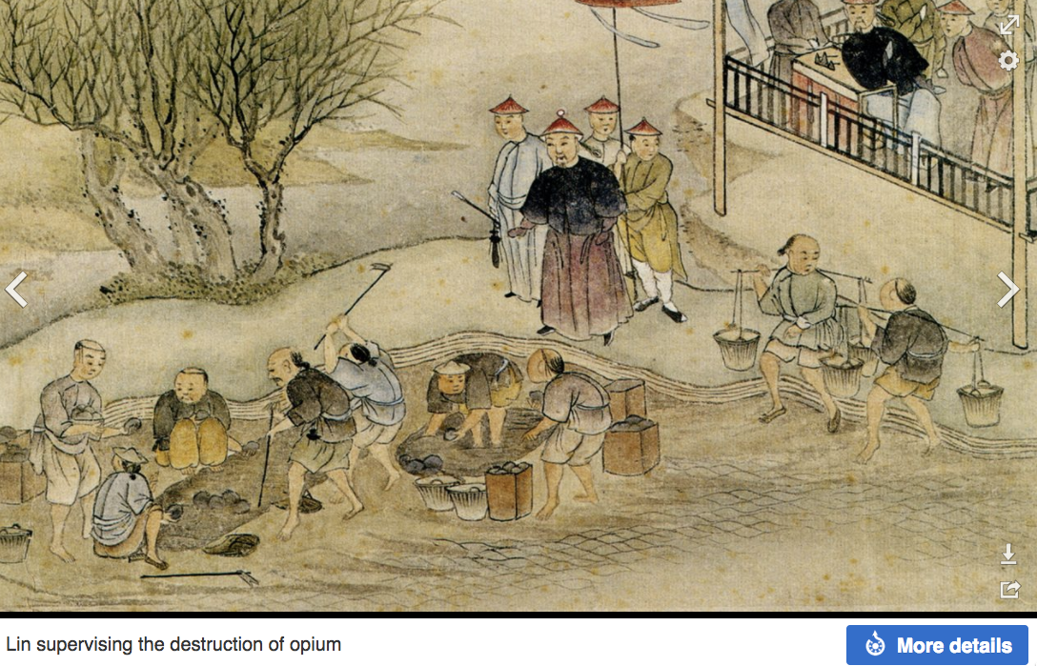
“Self-Strengthening”
The puzzle of China vs. Japan
Great Qing (大清)(1644-1912)
Wu Sangui (吳三桂)
The Rebellion of the Three Feudatories (三藩之亂)
Kangxi and Qianlong: “revere the emperor and expel the barbarians” is difficult to pursue when the emperor and his clan identify themselves as “barbarians”
Tai-Ping Rebellion (太平天國運動)
Cixi ( 慈禧太后)
Li Hongzhang (李鴻章)the Kai-Ping coal mine, Chang Yen-Mao, and Herbert Hoover

Slide 96
Formal Empires
There were, broadly, three views as to why European late-1800s empires rose to such domination, each of which with its own view of what was to be done to fix the situation:
One view is that of John Hobson: The major economic problem was the business cycle. Equipping the military needed to maintain the empire puts people to work. And an empire is a good source of consumers for the products of domestic factories. European governments that pursued empire, Hobson thought, were less likely to face economic distress and so more likely to continue in office.
A second view was that of Joseph Schumpeter: imperialism as the last gasp of military status aristocracy.
The third view was that empires were ordained by God—or at least morally required or desirable, for European powers had a civilizing mission. The Europeans were lucky enough to be the grownups, and it was the obligation of the grownups to civilize the world. But perhaps civilization is best spread by newspapers and books and merchants and engineers, rather than by alien proconsuls? Just a thought.

Slide 97
Informal Empires
But even where Britain (or France, or Germany, or Portugal, or Spain, or those who thought of themselves as descended from the conquistadores of Castile, or Anglo-Saxon settlers) did not rule, they reigned:
Britain seemed successful: playing by Britain’s rules seemed wise…
Britain was powerful: playing by Britain’s rules seemed likely to keep it from getting annoyed…
Britain was working very hard to make itself attractive—to make becoming a Briton-by-proxy of some sort straightforward and profitable in both money and cultural terms…
Britain was the first-mover hegemon: international cooperation was on its terms…

Slide 98
Catch Our Breath…
Comments?
Questions?

Slide 99
Review: Revolutions
“Petty Officer Lemmgen… arrived at the Ministry [of War]… found… Lieutenant HambuRger.... Lemmgen produced a typed document with the following text: ‘Comrades and Workers! The Ebert-Scheidemann government have made themselves impossible.... The undersigned Revolutionary Council has provisionally assumed power.’
“Lieutenant Hamburger inspected the document and became properly indignant. ‘But where are the signatures? Before I can comply with this order, you’ll have to go back and get it properly signed. Otherwise any little shorthand typist could declare the government deposed.’ Petty Officer Lemmgen... saw the logic…. So he and his men saluted... and made their way back to the Revolutionary Council to obtain the necessary signatures....
“But by the time he had obtained the signatures, Lemmgen had learned that the People’s Naval Division had declared itself neutral. So he did not return to the Ministry of War…”

Slide 100
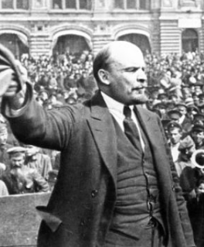
Lenin
A quick power grab…
Confidently expecting a German revolution, and then massive aid…
Brutal civil war
Kerenskyites
Reds
Whites
Nationalists
What was the revolutionary government to do?
Ludendorff’s German war economy…

Slide 101
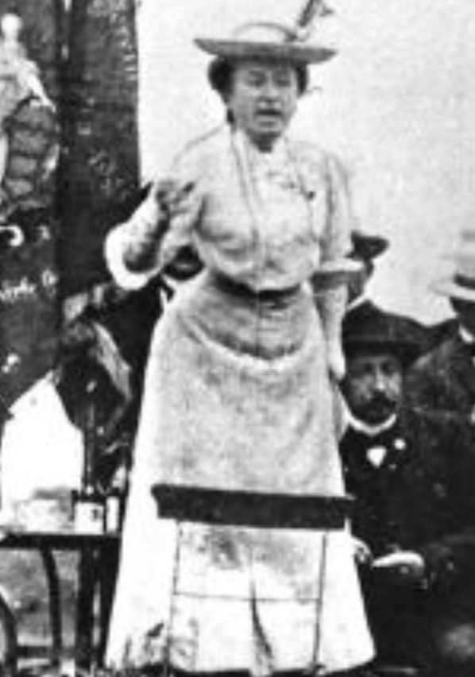
Red Rosa on Lenin
“Without general elections, without unrestricted freedom of press and assembly, without a free struggle of opinion, life dies out in every public institution…. Only the bureaucracy remains…. A few dozen party leaders of inexhaustible energy and boundless experience direct and rule….
“An elite of the working class is invited from time to time to meetings where they are to applaud the speeches of the leaders, and to approve proposed resolutions unanimously–at bottom, then, a clique affair…. Such conditions must inevitably cause a brutalization of public life: attempted assassinations, shooting of hostages, etc…
“Freedom only for the supporters of the government, only for the members of one party–however numerous they may be–is no freedom at all. Freedom is always and exclusively freedom for the one who thinks differently. Not because of any fanatical concept of “justice” but because all that is instructive, wholesome and purifying in political freedom depends on this essential characteristic, and its effectiveness vanishes when ‘freedom’ becomes a special privilege…

Slide 102

Review: The U.S.: The Roaring Twenties
The boom of the 1920s
Mass production—the flowering of the Second Industrial Revolution
“The business of America is business”
Structural changes in the 1920s…

Slide 103
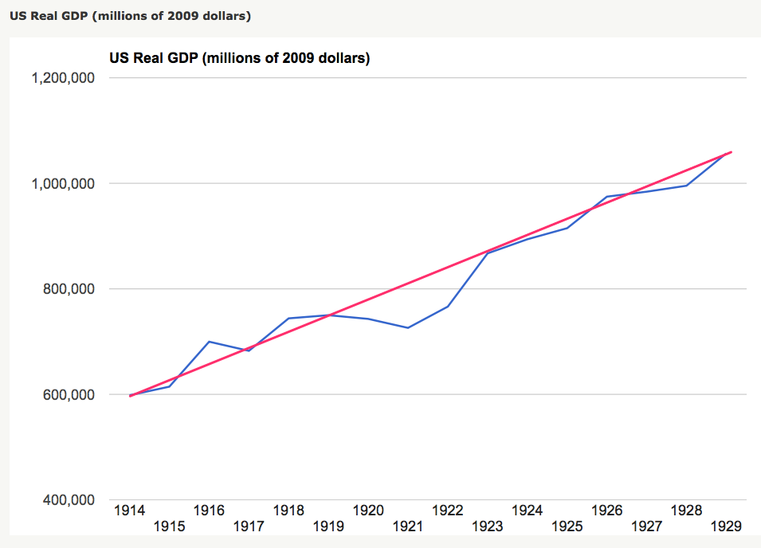
Structural Changes in the 1920s
Mass production—Henry Ford and the Model T
End of mass immigration—immigration restrictions of 1924
What do these do to the demand for construction, and construction workers?
The role of the stock market…
The role of the banking system…

Slide 104
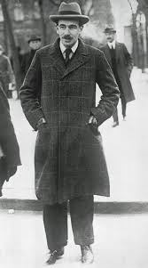
Review: To Your iClickers
John Maynard Keynes thought that the prosperity of the pre-WWI years was:
Natural and stable: a logical development out of human drives that went from strength to strength, and could only be overthrown by a very unlikely disaster.
Artificial and unstable, and based on a very complicated system in which, largely by chance, a lot happened to go right.
Natural but unstable, in that it was a logical development out of humanity’s trading nature but could be disturbed by other human drives—like tribalism, and the lust for domination.
Artificial but stable, as constructed by the greatest minds of the age, and only overthrown by a very unlikely disaster.
None of the above

Slide 105
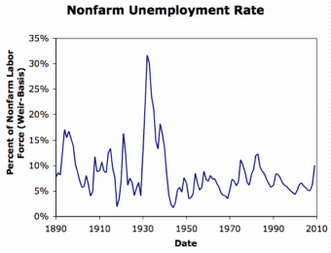
Review: Why the “Perfect Storm” of 1929-1933?
Previous Cycles:
1873—railroad
1884—railroad redux
1893—free silver
1904—Northern Securities
1907—gold drain to Britain
1914—disruption of the start of WWI
1920—deflation; return to “normalcy”
What brought previous downturns to a halt?
What made the Great Depression so great?

Slide 106
General Glut
How is it that there can be a "general glut" in which pretty much every produced commodity and the labor of workers are in excess supply, given that humans are far from satiated with production goods and given that one person's expenditure is another person's income?
Remember: you can take your income and use it either to buy things that are useful or to build up your stock of cash money. If there is excess demand for useful commodities, people can switch from producing whatever they were making to producing whatever is in short supply.
But the only way to build up your stock of cash is to try to cut your spending below your income. And since one person's spending is another person's income, that simply cannot be done in general.
If people in general try, the result is that spending and incomes fall economywide until they are both at such a low level that people de-prioritize building up their cash holdings.

Slide 107
What Had Ended Previous Downturns?
Previous Cycles:
1873—RR investment drops to zero
1884—RR investment drops to zero
1893—confidence that gold standard will be kept
1904—Theodore Roosevelt
1907—J.P. Morgan constitutes himself a pick-up central bank
1914—profits from European war demand WWI
1920—Federal Reserve reverses course

Slide 108
Interwar Gold Standard
The interwar gold standard caused, deepened, and definitely did nothing toward curing or ameliorating the Great Depression?
There is nothing worse than attempting to credibly commit to an incredible policy
The fear that the gold standard would break down caused people to want to hoard cash—to build up their cash holdings.
The fear that the gold standard would break down caused governments to be extremely unwilling to boost their economies' cash supplies—such boosts might, governments feared, undermine confidence that their country would stay on the gold standard.
Big depressions happen when the popular demand for cash outstrips the government's supply
The interwar gold standard was thus a powerful motivator and stage-setter pushing both people and governments into the patterns of behavior that produced the Great Depression

Slide 109
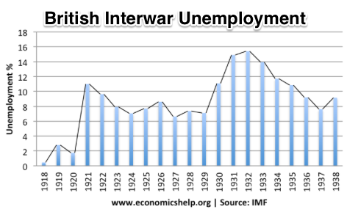
“Crying ‘Fire! Fire!’ in Noah’s Flood…”
France gold acquisition policy
American gold acquisition policy
The weakness of the gold-exchange standard—that people knew the gold standard could and would be abandoned
Labor-side pressure…
Nothing worse than an attempt to credibly commit to an incredible policy…
And then the belief that inflation was always just around the corner…

Slide 110
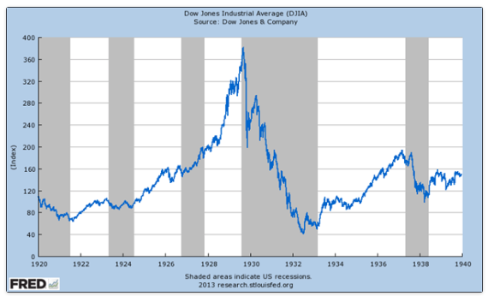
The Role of the Stock Market
Stock market doubles between the start of 1927 and late 1929
Positive-feedback margin trading
And a large number of people coming into the market who do not understand what is going on
Castles in the air
Prohibition?
Monetary policy?
Mass production?
The expectations shock produced

Slide 111
Why Was the Great Depression so Great?
John Maynard Keynes:
“When once the recovery has been started, the manner in which it feeds on itself and cumulates is obvious. But during the downward phase, when both fixed capital and stocks of materials are for the time being redundant and working-capital is being reduced, the schedule of the marginal efficiency of capital may fall so low that it can scarcely be corrected, so as to secure a satisfactory rate of new investment, by any practicable reduction in the rate of interest.
“Thus with markets organised and influenced as they are at present, the market estimation of the marginal efficiency of capital may suffer such enormously wide fluctuations that it cannot be sufficiently offset by corresponding fluctuations in the rate of interest. Moreover, the corresponding movements in the stock-market may, as we have seen above, depress the propensity to consume just when it is most needed. In conditions of laissez-faire the avoidance of wide fluctuations in employment may, therefore, prove impossible without a far-reaching change in the psychology of investment markets such as there is no reason to expect.
“I conclude that the duty of ordering the current volume of investment cannot safely be left in private hands….”

Slide 112
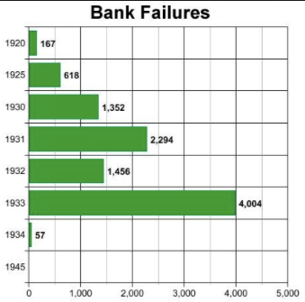
The Role of the Banking System
In the United States in the 1920s, about 600 banks failed a year—largely small rural banks
But banks set out to make riskier and riskier loans
Do they count on rescue from the Federal Reserve?
And when the Great Depression hits, bank failures rise to previously-unimaginable heights
Is there anything that could do more to boost the demand for or reduce the supply of cash?
And so call forth a general glut?
Lenders of “last resort”?

Slide 113
The Presumption Before the Great Depression
The presumption before the Great Depression that the government was not responsible for managing and curing the business cycle…
Two strands reinforced each other.
The first was the strength of the idea of laissez-faire: that government (protecting property and enforcing contracts aside) was overwhelmingly a problem and not a solution. As John Maynard Keynes wrote in his essay The End of Laissez-Faire, a powerful drive behind that was: “the corruption and incompetence of eighteenth-century government…. Almost everything which the State did in the eighteenth century in excess of its minimum functions was, or seemed, injurious or unsuccessful. [And] on the other hand, material progress between 1750 and 1850 came from individual initiative…”
The second was social Darwinism—that, in the words of steelmaster Andrew Carnegie, the second-richest man in America circa 1905 and a man who gave away his entire fortune: “The price we pay for [our civilization]... is, no doubt, great.... The employer of thousands is forced into the strictest economies... [in] the rates paid to labor.... The law of competition... is here; we cannot evade it; no substitutes for it have been found; and while the law may be sometimes hard for the individual, it is best for the race, because it insures the survival of the fittest in every department..."
The result was a dominant belief—at least among the rich and powerful—that:
The market giveth, the market taketh away: blessed be the name of the market.

Slide 114
The Hoover Administration’s Reaction to the Great Depression
The 1929-1933 Hoover administration believed that little could be done.
That the only good things that could be done were to (a) repeatedly state that "prosperity is just around the corner" and (b) try to cut federal government spending and raise taxes in order to restore confidence and scotch the fear of high inflation.
As economist R.G. Hawtrey wrote, to worry about inflation in the midst of the Great Depression was like "crying 'FIRE! FIRE!' in Noah's Flood..."
Herbert Hoover himself wrote afterwards about how his administration had been dominated by the "'leave-it-alone liquidationists' headed by Secretary of the Treasury Mellon, [who] felt that government must keep its hands off and let the slump liquidate itself. Mr. Mellon had only one formula:
'Liquidate labor, liquidate stocks, liquidate the farmers, liquidate real estate'. He held that even panic was not altogether a bad thing. He said: 'It will purge the rottenness out of the system. High costs of living and high living will come down. People will work harder, live a more moral life. Values will be adjusted, and enterprising people will pick up the wrecks from less competent people'…"
Hoover went on to state that he did not share this view…
That raises lots of questions about how his administration worked…

Slide 115
To Your iClickers
The largest automobile manufacturer in the world in 1928 was:
Toyota
Daimler-Benz
Peugeot
Ford
General Motors

Slide 116
To Your iClickers…
Worldwide, the Great Depression was was:
In relative terms, equalled by the Cleveland Depression of 1893-6
In relative terms, smaller than the depression that followed the Crash of 1873
In relative terms, equalled by the Great Recession of 2008-2020
In relative terms, by far the largest depression ever
None of the above

Slide 117
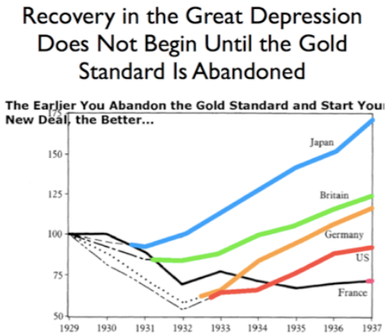
Review: New Deals
Japan: Takahashi Korekiyo
moved early to maintain full employment
Britain: MacDonald-Snowden-Baldwin
Forced off…
Germany: Adolf Hitler
Succeeds Bruening
America: Franklin Delano Roosevelt
Succeeds Herbert Hoover
France: Leon Blum

Slide 118
Recovery
Japan recovered the fastest,
Germany second,
Britain third,
The U.S. fourth,
France last.
By-and-large, the sooner you abandon the gold standard, expand the money supply, and undertake a "New Deal" to boost government spending, the better…

Slide 119
The Polanyian Perplex
People believe that the rights they have are broader and deeper than simply property rights, but the market economy disagrees.
Thus either governments will find a way to guarantee their populations these extra rights to community stability, general prosperity, and full employment, or society will react somehow against the liberal market-oriented political-economic system.
“Fictitious commodities”:
Land
Labor
Finance
Society’s “double movement”

Slide 120
The Permanent Problem of the Human Race
John Maynard Keynes thought that the economic problem would not be the "major problem of the human race"
By the end of the twentieth century the human race would be so rich that people would be practically satiated with commodities.
Thus the "economic problem" of how to economize and be efficient, and allocate scarce means among alternative uses, was not the permanent problem of the human race.
Instead, "for the first time since his creation man will be faced with his real, his permanent problem-how to use his freedom from pressing economic cares, how to occupy the leisure, which science and compound interest will have won for him, to live wisely and agreeably and well.... It will be those peoples, who can keep alive, and cultivate into a fuller perfection, the art of life itself and do not sell themselves for the means of life, who will be able to enjoy the abundance when it comes..."
Yet Keynes was not sure that having to confront this problem would be a net plus for humanity: "Will this be a benefit? If one believes at all in the real values of life, the prospect at least opens up the possibility of benefit. Yet I think with dread of the readjustment of the habits and instincts of the ordinary man, bred into him for countless generations, which he may be asked to discard within a few decades..."

Slide 121
Digression: How to Study
Will I ask you about Jan Christian Smuts? About the prayer (and theology) of the Grigua?
No…
Themes and concepts…
But you need narratives and stories to hang onto them…
And our brains are very good at deep-sixing useless information
Andy Matuschak: Why Books Don’t Work <https://andymatuschak.org/books/>:
“Picture some serious non-fiction tomes. The Selfish Gene; Thinking, Fast and Slow; Guns, Germs, and Steel; etc.
“Have you ever had a book like this—one you’d read—come up in conversation, only to discover that you’d absorbed what amounts to a few sentences? I’ll be honest: it happens to me regularly. Often things go well at first. I’ll feel I can sketch the basic claims, paint the surface; but when someone asks a basic probing question, the edifice instantly collapses. Sometimes it’s a memory issue: I simply can’t recall the relevant details. But just as often, as I grasp about, I’ll realize I had never really understood the idea in question, though I’d certainly thought I understood when I read the book. Indeed, I’ll realize that I had barely noticed how little I’d absorbed until that very moment. I know I’m not alone here…

Slide 122
Skipped Topic: Pre-1914 Political Economy: Over in Europe
The June Days of 1848 in Paris:
Tocqueville:
“The insurrection of June [1848]... class against class... a blind and rude, but powerful, effort on the part of the workmen to escape from the necessities of their condition, which had been depicted to them as one of unlawful oppression…. The closing of the national workshops… occasioned the rising…”
“Thousands… hastening to our aid from every part of France.... Thanks to the railroads, some had already come from fifty leagues’ distance... every class of society... peasants... shopkeepers... landlords and nobles all mingled together... they rushed into Paris with unequalled ardour: a spectacle as strange and unprecedented in our revolutionary annals.... The insurgents received no reinforcements, whereas we had all France for reserves…”

Slide 123
French Politics
Régimes stability is not on the menu:
the terrorist dictatorship of the Jacobins (the mainspring of popular government… amid revolution it is at once virtue and terror: virtue, without which terror is fatal; terror, without which virtue is impotent…)
a corrupt and gerrymandered 5-man executive of the Directory, defended on October 5, 1795 by the “whiff of grapeshot” of Napoleon Bonaparte and Joachim Murat, that managed to generate the first modern hyperinflation, defended itself against a royalist coup plotted by two of its five members (Barthelemy and Carnot) and its most successful general (Pichegru), and was then overthrown by the same Napoleon in 1799.
a dictatorship, with Napoleon Bonaparte as “First Consul”, until 1804.
an empire, with Napoleon Bonaparte as Emperor of the French, until suppressed by the other European powers in 1815.
a restored Bourbon monarchy, with first Louis XVIII and then Charles X, until 1830.
an alternative Orleanist monarchy, with King Louis-Philippes as the king-citizen, overthrown in 1848.
a second republic, overthrown by its own president, Napoleon’s nephew Louis Napoleon, which collapsed under pressure of military defeat in 1870.
a socialist commune, in Paris at least.
a third republic, which suppressed the commune—but promptly chose a royalist Marshal MacMahon, as president.
a failed attempt by third republic president Marshal MacMahon to replace himself by a King Henry V.
a failed attempt by the ex-Minister of War Georges Boulanger to seize power for his RRR movement: Revanche, Révision, Restauration (revenge on Germany, revision of the constitution, restoration of the monarchy).

Slide 124
Left-Wing Normal European Politics I
Disjunction between policies and rhetoric:
The Socialist Party of Germany’s Erfurt and Gotha programs seek things like: holidays for elections, two-year legislative terms, the right to bear arms, equal rights for women, the prohibition of spending public funds for religious purposes, free public schools and colleges, free medical care including midwifery, an eight-hour working day, no child labor under 14, a 36-hour minimum weekend, an occupational safety and health administration…

Slide 125
Left-Wing Normal European Politics II
Disjunction between policies and rhetoric:
But also: “By every lawful means to bring about a free state and a socialistic society, to effect the destruction of the iron law of wages by doing away with the system of wage labor.” And they sought: “the transformation of the capitalist private ownership of the means of production—land and soil, pits and mines, raw materials, tools, machines, means of transportation—into social property and the transformation of the production of goods into socialist production carried on by and for society.” And they believed: “This… emancipation… of the entire human race…. But it can only be the work of the working class, because all other classes… have as their common goal the preservation of the foundations of contemporary society.”

Slide 126
Center and Right-Wing Normal European Politics
The touchstone was “fairness”: it was not fair that those who did not work hard and did not play by the rules got lots of good things:
Those who did not play by the rules could be on either end of the wealth-and-power spectrum:
Parasitic aristocrats and cruel plutocrats
Those poor who wanted something for nothing, or got above their station
A middle-class, social order movement
Focus voters’ attention on the disruptive utopian aspirations of the left, and electoral coalitions could be preserved…
Preserve as much as possible of old orders of hierarchy in changing times:
Reform to preserve; change so things could stay the same
Find new reasons why hierarchy is good: social darwinism

Slide 127
Magnifying Non-Economic Cleavages Had Dangers
Society under threat not by economic inequality but by social disorder—or aliens—or other nations. Plus:
A right-wing landed and bureaucratic upper class that had, by and large, lost its social role.
A belief by politicians anxious to paper over class divisions that they could be papered over with national or ethnic unity.
A growing social-darwinist current that struggle was good, and the victors should be rewarded
Even or especially military struggle by peoples-in-arms, over not what language a province would be administered in but who would live there
These stored up trouble as 1914 approached.
In 1919 John Maynard Keynes was to write, bitterly, that he, his peers, and his elders had regarded:
“the projects and politics of militarism and imperialism, of racial and cultural rivalries, of monopolies, restrictions, and exclusion, which were to play the serpent to this paradise… [as] little more than the amusements of his daily newspaper…”

Slide 128
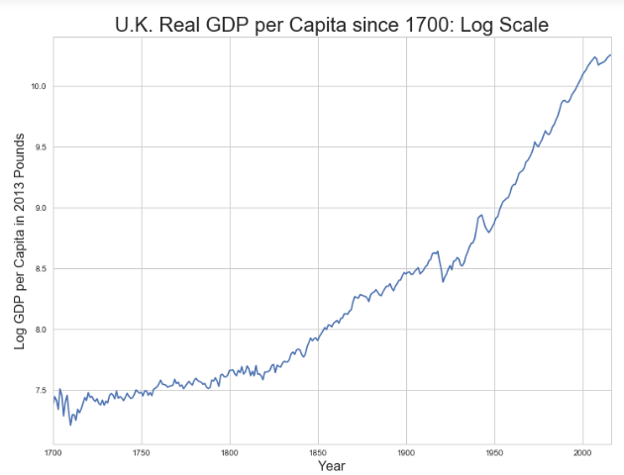
Skipped Topic: Passing the Baton: From Britain to America
The Industrial Revolution took place in Britain
The standard explanation four or five largely independent strands coming together.:
Limited government, security of property, and freedom of contract
Science and the technological tradition of sustained inquiry
Victory in the wars of the Commercial Revolution era
Machinery making, "tinkering", and "gadgets"—primarily made out of metal.
Coal in Britain—the only thing that made a steam engine potentially profitable.
Plus high elasticity of demand for leading-sector products…
http://bradford-delong.com brad.delong@gmail.com

Slide 129
iClickers: Why Breaktrhrough?
The principal reason that the Industrial Revolution took place in late eighteenth century Britain (rather than in Sung China, or Abbasid Baghdad, or Antonine Dynasty Rome, or during the Hellenistic Age) is:
A lack of human numbers thinking about problems of production
A lack of good means of communication—e.g. printing—for diffusing information about how to solve problems of production
A lack of experience using coal as an energy source
A lack of the incentive created by high real wages leading to a strong desire to make labor more productive
None of the above/not enough information
http://bradford-delong.com brad.delong@gmail.com

Slide 130
iClicker: Why Passing the Baton
The principal reason that the twentieth century was an American rather than a second British century was:
The United States’s aggressive and enthusiastic welcome of immigrants
The United States’s focus on broad-based technical education
The United States’s extraordinary abundance of natural resources driving high real wages and enormous incentives to build machines to manipulate matter
A U.S. government that took industrial development as a key policy goal, rather than being comfortable with laissez-faire
None of the above/not enough information
http://bradford-delong.com brad.delong@gmail.com

Slide 131
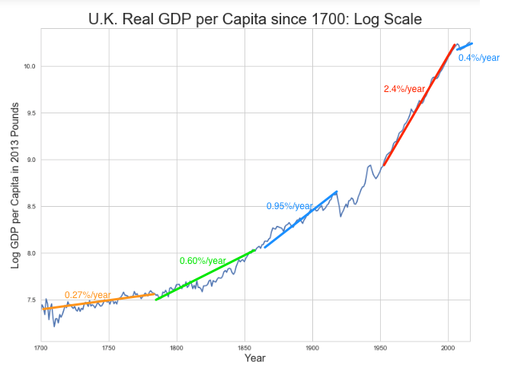
British Productivity Growth Acceleration
http://bradford-delong.com brad.delong@gmail.com

Slide 132
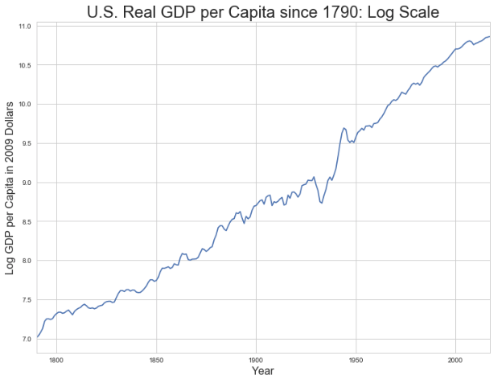
But Even in the First Half of the Nineteenth Century the U.S. Was Outpacing Britain in Growth…
Even in the first half of the nineteenth century—the period in which the British Industrial Revolution made it the wonder of the world—economic growth in the United States was proceeding faster than in Britain.
While British real GDP per capita was increasing at less than 0.6 percent per year
American was growing at a hair over one percent per year.
And a significantly larger share of GDP was going to the white working class in the United States, in the north at least:
The extraordinary abundance of land and the possibility of "lighting out for the territory", in the words of American author Mark Twain, gave even workers without property or notably scarce skills substantial economic bargaining power.
http://bradford-delong.com brad.delong@gmail.com

Slide 133
And Starting in the Late Nineteenth Century
Second Industrial Revolution…
Why the U.S. and Germany, and not Britain?
Immigration and Population
Was resource scarcity no longer a factor?
Was the differential in the growth rate h of the stock of useful economic knowledge even greater than the differential in the growth rate g of the efficiency-of-labor?
http://bradford-delong.com brad.delong@gmail.com

Slide 134
Phases of American Growth
1.0% per year in GDP per capita from 1760-1860: resource abundance
1.6% per year in GDP per capita from 1860-1929:
“Great traverse”: K/Y ratio up from 2.5 to 4
Half of it an increase in savings rates
Half of it a fall in the price of capital goods
2.5% per year in GDP per capita from 1929-1973
“Fordism”
Expected further acceleration: it did not happen
Post-1973
Productivity slowdown 1973-1995 (environment, oil, baby boom, feminism)
“New economy” 1995-2006
Post-2006 collapse of growth
http://bradford-delong.com brad.delong@gmail.com

Slide 135
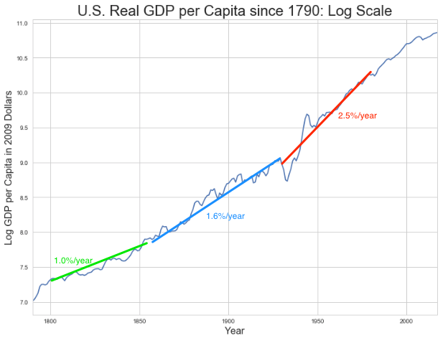
American Productivity Growth Acceleration
http://bradford-delong.com brad.delong@gmail.com

Slide 136
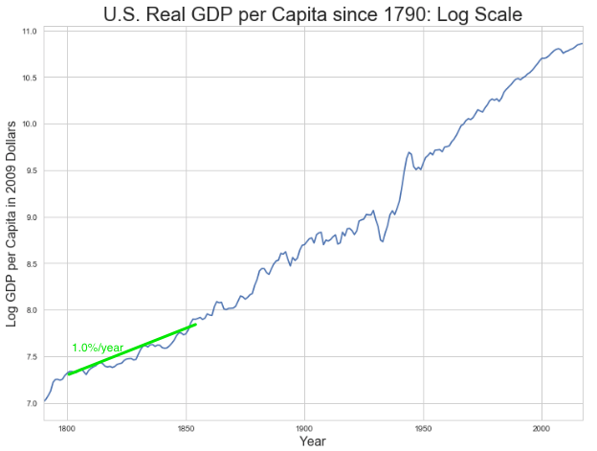
Early Nineteenth Century: Westward Expansion
Westward expansion
The “American System”
Abundant natural resources
Very high real wages
Focus on raising labor productivity
Hence fast efficiency-of-labor growth
Britain, by contrast, focused on economizing on (non-coal) raw materials
http://bradford-delong.com brad.delong@gmail.com

Slide 137
The Importance of Resources 1760-1860
Major westward expansion and "Amerindian removal”
The century 1760 to 1860 before the Civil War.
We have U.S. output-per-worker growth then at about 1.0% per year…
…in contrast to British output-per-worker growth at about 0.5% per year.
We have the U.S. population and labor force growing at 2.5% per year…
…from 2.5 to 30 million.
http://bradford-delong.com brad.delong@gmail.com

Slide 138


The Importance of Resources 1760-1860
Recall our basic Solow Model:
http://bradford-delong.com brad.delong@gmail.com

Slide 139

The Importance of Resources 1760-1860
Recall our basic Solow Model:
Assume K/Y constant, so the growth rate g of the efficiency of labor and the growth rate of output-per-worker are the same:
http://bradford-delong.com brad.delong@gmail.com

Slide 140
The Importance of Resources 1760-1860
Recall our basic Solow Model:
Assume K/Y constant, so the growth rate g of the efficiency of labor and the growth rate of output-per-worker are the same:
http://bradford-delong.com brad.delong@gmail.com

Slide 141
The Importance of Resources 1760-1860
Recall our basic Solow Model:
Assume K/Y constant, so the growth rate g of the efficiency of labor and the growth rate of output-per-worker are the same:
Let’s, last, fit this to history in the century before the 1860 election of President Abraham Lincoln and the ensuing American Civil War:
http://bradford-delong.com brad.delong@gmail.com

Slide 142

The Importance of Resources 1760-1860
Recall our basic Solow Model:
Assume K/Y constant, so the growth rate g of the efficiency of labor and the growth rate of output-per-worker are the same:
Let’s, last, fit this to history in the century before the 1860 election of President Abraham Lincoln and the ensuing American Civil War:
http://bradford-delong.com brad.delong@gmail.com

Slide 143

Westward Expansion
http://bradford-delong.com brad.delong@gmail.com

Slide 144

The Importance of Resources 1760-1860
We have two parameters left: γ and h, the weight of ideas in efficiency-of-labor growth and the rate of growth of the stock of useful ideas for the economy in American heads, respectively:
http://bradford-delong.com brad.delong@gmail.com

Slide 145

The Importance of Resources 1760-1860
We have two parameters left: γ and h, the weight of ideas in efficiency-of-labor growth and the rate of growth of the stock of useful ideas for the economy in American heads, respectively:
http://bradford-delong.com brad.delong@gmail.com

Slide 146
The Importance of Resources 1760-1860
Thus if γ→∞ then h→0.010
http://bradford-delong.com brad.delong@gmail.com

Slide 147
The Importance of Resources 1760-1860
Thus if γ→∞ then h=0.010
Thus if γ=3.0 then h=0.00667
http://bradford-delong.com brad.delong@gmail.com

Slide 148
The Importance of Resources 1760-1860
Thus if γ→∞ then h=0.010
Thus if γ=3.0 then h=0.00667
Thus if γ=1.0 then h=0.00
http://bradford-delong.com brad.delong@gmail.com

Slide 149
The Importance of Resources 1760-1860
Thus if γ→∞ then h=0.010
Thus if γ=3.0 then h=0.00667
Thus if γ=1.0 then h=0.00
Looking across the Atlantic Ocean to Great Britain, we see that over there it is indeed the case that h=0.005 from 1760 to 1860. Faster growth of h in America due to some catchup with the world's first and leading industrial nation seems likely. So γ=3.0 has some claim to be the most likely value…
http://bradford-delong.com brad.delong@gmail.com

Slide 150
A Counterfactual
The Royal Proclamation of October 1763:
Our Royal Will and Pleasure… no... Governor or Commander in Chief in... our... Colonies or Plantations in America do... grant Warrants of Survey, or pass Patents for any Lands beyond the Heads or Sources of any of the Rivers which fall into the Atlantic Ocean from the West and North West, or upon any Lands whatever, which, not having been ceded to or purchased by Us as aforesaid, are reserved to the said Indians, or any of them...
http://bradford-delong.com brad.delong@gmail.com

Slide 151

What If This Royal Proclamation Had Stuck?
What if ρ=0?
If γ → ∞ and h=0.010 then g=0.01
If γ=3.0 and h=0.00667 then g=−0.00125
If γ=1.5 and h=0.000 then g=−0.01
http://bradford-delong.com brad.delong@gmail.com

Slide 152
What If This Royal Proclamation Had Stuck?
What if ρ=0?
If γ → ∞ and h=0.010 then g=0.01
If γ=3.0 and h=0.00667 then g=−0.00125
If γ=1.5 and h=0.000 then g=−0.01
An America penned behind the Appalachians would probably have seen its living standards and productivity levels not growing at 1% per year from 1760 to 1860 but shrinking.
For γ=3.0, living standards and productivity levels would have shrunk at a pace of -0.125% per year
http://bradford-delong.com brad.delong@gmail.com

Slide 153
What If This Royal Proclamation Had Stuck?
What if ρ=0?
Of course, a poorer America would probably have seen fewer immigrants.
But it might not have seen that many fewer immigrants.
It would no longer have been quite as attractive to move from Britain to America over 1760 to 1860.
But it still would have been very attractive to move from France, Germany, Scotland—or most of all from Potato Blight-ridden Ireland...
In what other ways might this counterfactual alternate-history "little America" would likely have been different in 1860 than America actually was?
http://bradford-delong.com brad.delong@gmail.com

Slide 154

“Trail of Tears’
http://bradford-delong.com brad.delong@gmail.com

Slide 155
A large chunk of America's pre-1860 visible growing prosperity was based not just on African-American slavery, but also on "Amerindian removal"
http://bradford-delong.com brad.delong@gmail.com

Slide 156
Catch Our Breath…
Ask me two questions…
Make two comments…

Slide 157

Late Nineteenth-Early Twentieth Century: “Great Traverse”
Invention of the industrial research lab
First globalization
Technologies of Second Industrial Revolution
Economies of scale and mass production
Falling price of capital goods
Greater savings effort
Plus mass immigration
Rapidly rising inequality
Or was it? Emancipation…
http://bradford-delong.com brad.delong@gmail.com

Slide 158
Capital Deepening
Lowered deprecation rate δ
From 5% to 3% per year
http://bradford-delong.com brad.delong@gmail.com

Slide 159
Capital Deepening
Lowered deprecation rate δ
From 5% to 3% per year
Increased savings rate s
Capital-output ratio goes from 2.5 to 4 across 70 years
http://bradford-delong.com brad.delong@gmail.com

Slide 160
Capital Deepening
Lowered deprecation rate δ
From 5% to 3% per year
Increased savings rate s
Capital-output ratio goes from 2.5 to 4 across 70 years
with an α=1, output-per-worker proportional to the capital-output ratio
ln(4/2.5)/70 = 0.007
g = 0.9%/year
http://bradford-delong.com brad.delong@gmail.com

Slide 161
Capital Deepening
Capital-output ratio goes from 2.5 to 4 across 70 years
with an α=1, output-per-worker proportional to the capital-output ratio
ln(4/2.5)/70 = 0.007
g = 0.9%/year
Second Industrial Revolution
Large managerial corporation
Large-scale investment banking
Industrial research lab
Continent-wide market
Globalization
http://bradford-delong.com brad.delong@gmail.com

Slide 162

Mid Twentieth Century: Drive to High Mass Consumption
DARPA, etc.: two heads are better than one
“Fordist” oligopolies
Second globalization
Keynesian stabilization policies
Falling and then low inequality
For white guys…
http://bradford-delong.com brad.delong@gmail.com

Slide 163
Mid Twentieth Century: Drive to High Mass Consumption
DARPA, etc.: two heads are better than one
“Fordist” oligopolies
Second globalization
Keynesian stabilization policies
Falling and then low inequality
For white guys…
http://bradford-delong.com brad.delong@gmail.com

Slide 164
Catch Our Breath…
Ask me two questions…
Make two comments…

Slide 165
Notes

